Slide 1


Assessing the Impact of Air Pollution Exposure on Travel Behaviour
by
Kapil Kumar Meena
Supervisor:
Prof. Arkopal Kishore Goswami
Ranbir and Chitra School of Infrastructure Design and Management
22th August
Extension Seminar Presentation

Slide 2
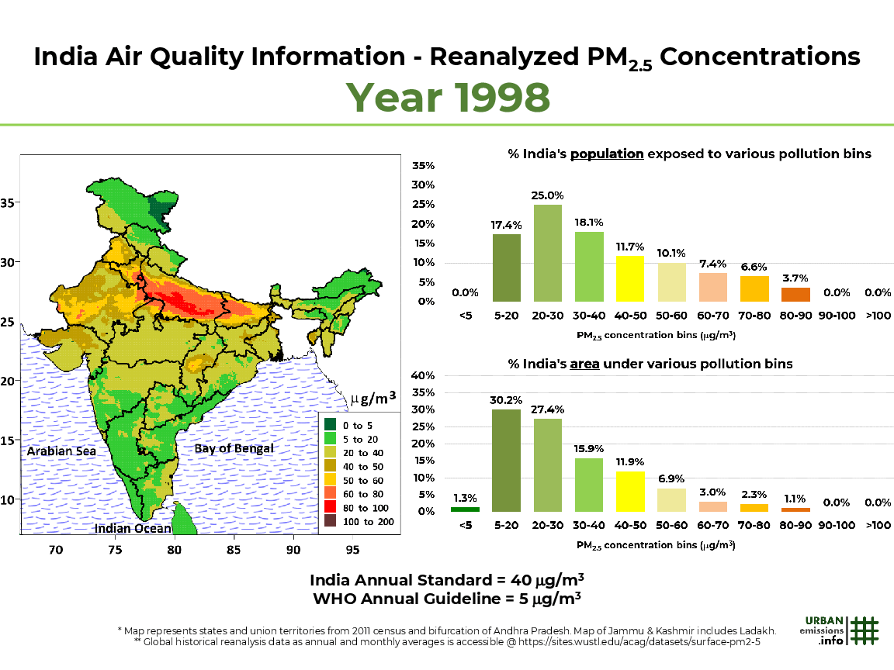

Background: The Invisible Crisis Globally
99%
5 Years
99% of the world’s population lived in areas that exceeded the WHO guideline for PM2.5 (WHO, 2023).
Life Expectancy Reduced by 5 years (Greenstone and Fan,2020)
16 to 23 months
2nd
Air pollution collectively reduced life expectancy by 16 to 23 months in India (State Of Global Air/2019)
India is the second most polluted country in the World (Greenstone and Fan, 2020)
5th
1.7 Million
Air pollution is the fifth leading risk factor for mortality worldwide
(State Of Global Air/2019).
In India, 1.7 million deaths were due to air pollution in 2019 (The Lancet Planetary Health Study, 2021).
Indian Institute of Technology Kharagpur, India

Slide 3
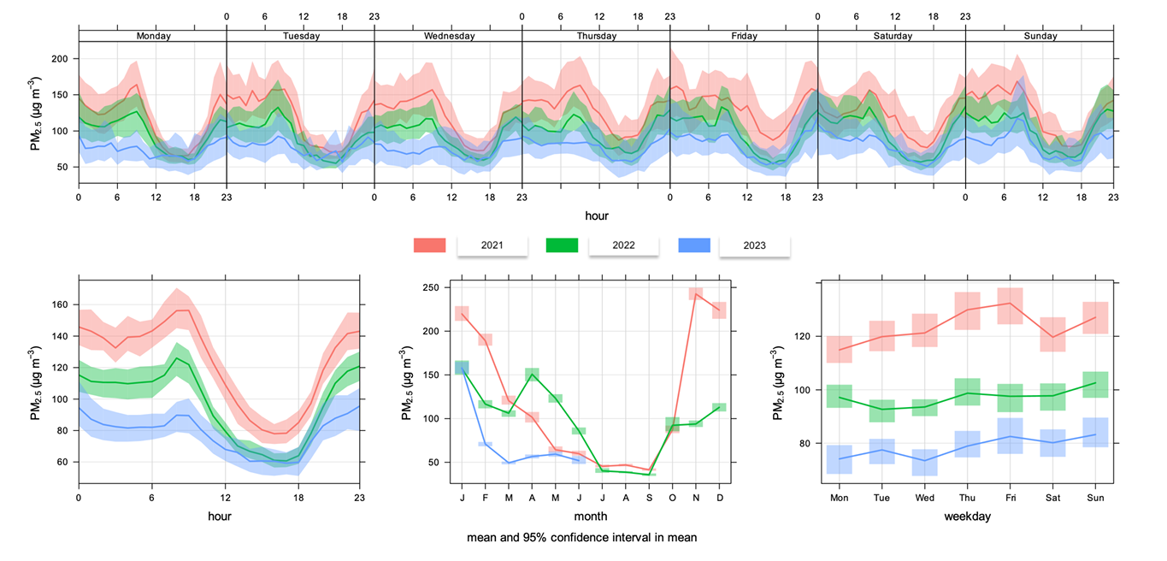
Background: The Invisible Crisis in INDIA
Diurnal PM2.5 Trend in Kolkata
Indian Institute of Technology Kharagpur, India

Slide 4
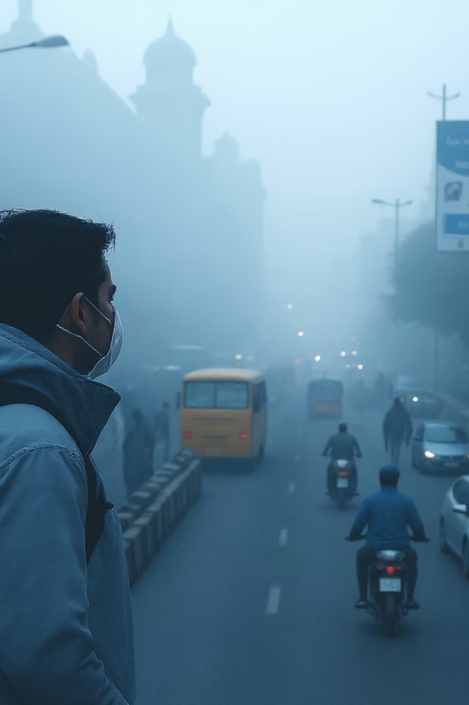
Big Question
Air Pollution Exposure and Travel Behavior: Is There a Link?
YES, a Significant One.
Travel is one of the activities where commuters are most exposed to air pollution in daily life (Singh et al. 2021).
On average, 8% of time spent in transport is responsible for 32.7% of exposure (Dons et al. 2019) and more the time, more the exposure (concentration * travel time).
Indian Institute of Technology Kharagpur, India

Slide 5
Empirical Evidence: Travel and Exposure
Author | Country | Exposure during activities
Beckx et al., 2009 | Netherlands | Highest exposure is estimated for in-transport, followed by workplaces, shopping areas and home activities
Dons et al., 2012 | Belgium | Travelling (6% of 24 hours), the in-transport results in 21% of black carbon exposure. Concentrations levels in transport is found to be 2-5 times higher than home.
Dons et al., 2019 | Belgium, Spain and United Kingdom | 8% time spent in transport is responsible for 32.7% of exposure
Shekarrizfard et al., 2020 | Toronto | For UFP and BC, the mobility based exposure is 11.6% and 63.2% higher than home based exposure.
Smith et al., 2016 | London | People spend 94.7 to 97.9% of their time indoors and 2.1 to 5.3% in transit and responsible for 30% exposure.
Lu et al., 2019 | Netherlands | Travel contribution to NO2 exposure is between 8.0 and 18.8% and to outdoor PM10 is between 4.1 and 12.2%.
Inferences: Commuters experience significantly higher exposure to pollutants while outside home/indoors
during travel.
Indian Institute of Technology Kharagpur, India

Slide 6
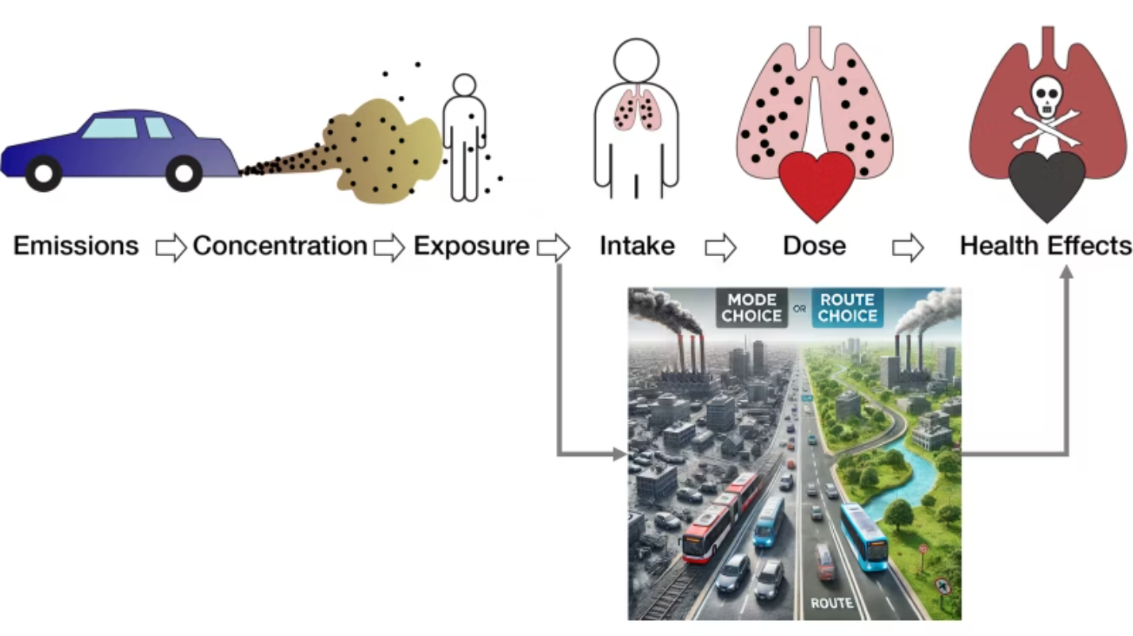
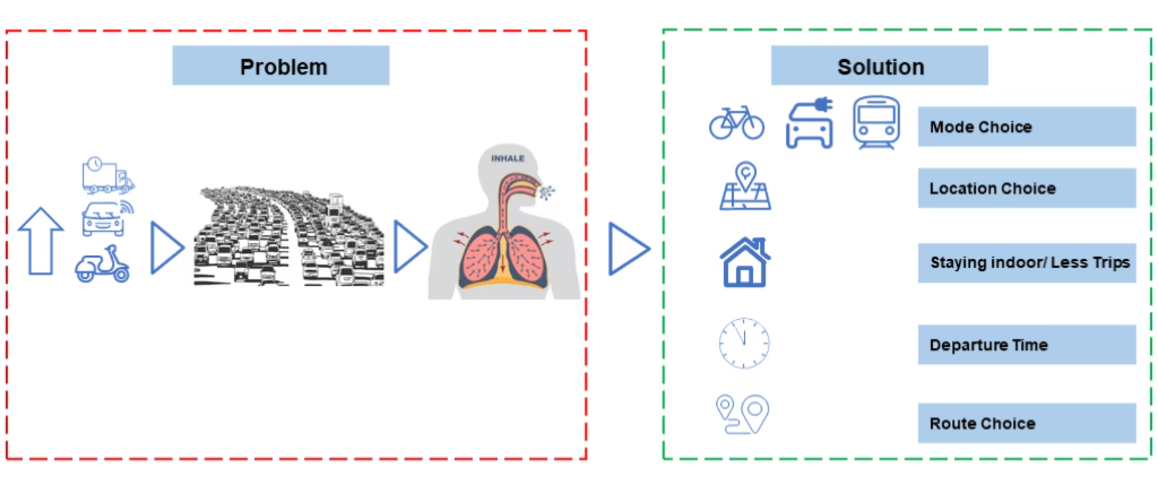
Addressing the Challenge
The Problem
The Solution
Indian Institute of Technology Kharagpur, India

Slide 7
Research Questions?
How can a panel-based RP–SP survey be designed and implemented in the Indian urban context to capture seasonal variation (winter and summer) in travel behaviour?
How do travellers in Kolkata perceive and respond to air quality information in terms of route and mode choice decisions?
To what extent does travel behaviour vary across seasons (winter and summer) when air pollution levels differ significantly?
How can latent heterogeneity in awareness, attitudes, and protective actions be modelled to explain variations in behavioural responses?
In what ways can modelling insights be operationalised into decision-support tools (such as personalised routing applications and dashboards) to reduce exposure and support sustainable mobility?
What are the key factors that influence individual exposure to air pollution during daily travel in urban settings?
1
Key Research Questions
2
3
4
5
6
Indian Institute of Technology Kharagpur, India

Slide 8
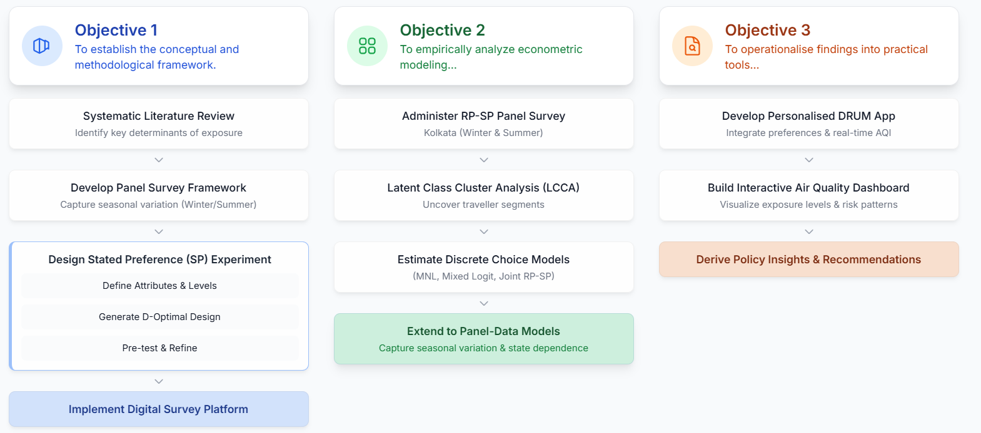
Research Objectives & Framework
Key Research Questions
Indian Institute of Technology Kharagpur, India

Slide 9
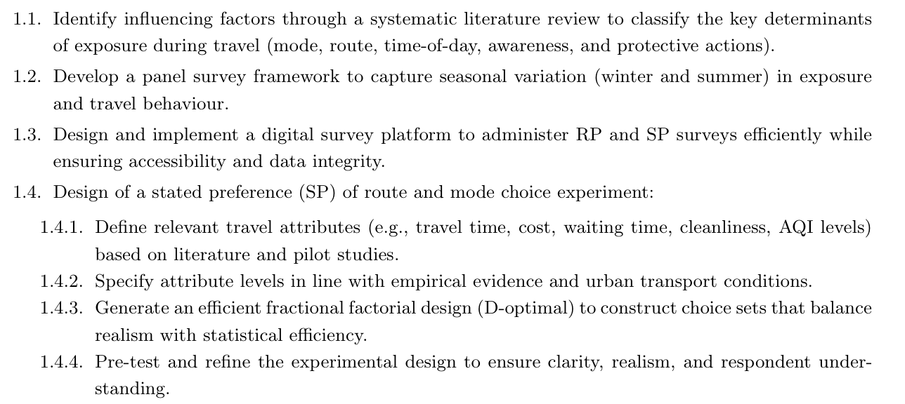
Objective – 1
Key Research Questions
Indian Institute of Technology Kharagpur, India

Slide 10
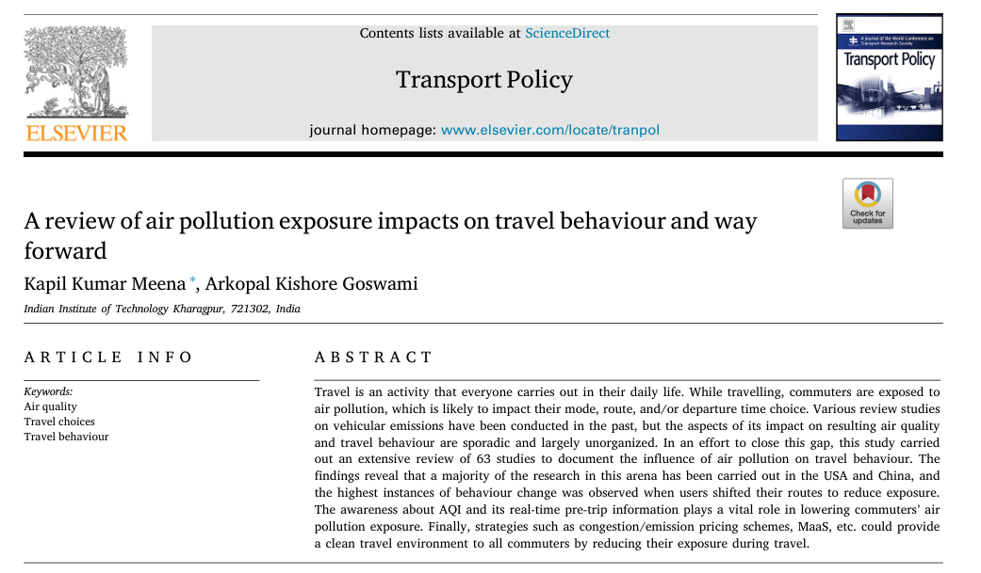
Objective – 1.1:Factors identifications
1. Identify influencing factors through a systematic literature review to classify the key determinants of exposure during travel (mode, route, time-of-day, awareness, and protective actions).
Key Research Questions
Indian Institute of Technology Kharagpur, India

Slide 11
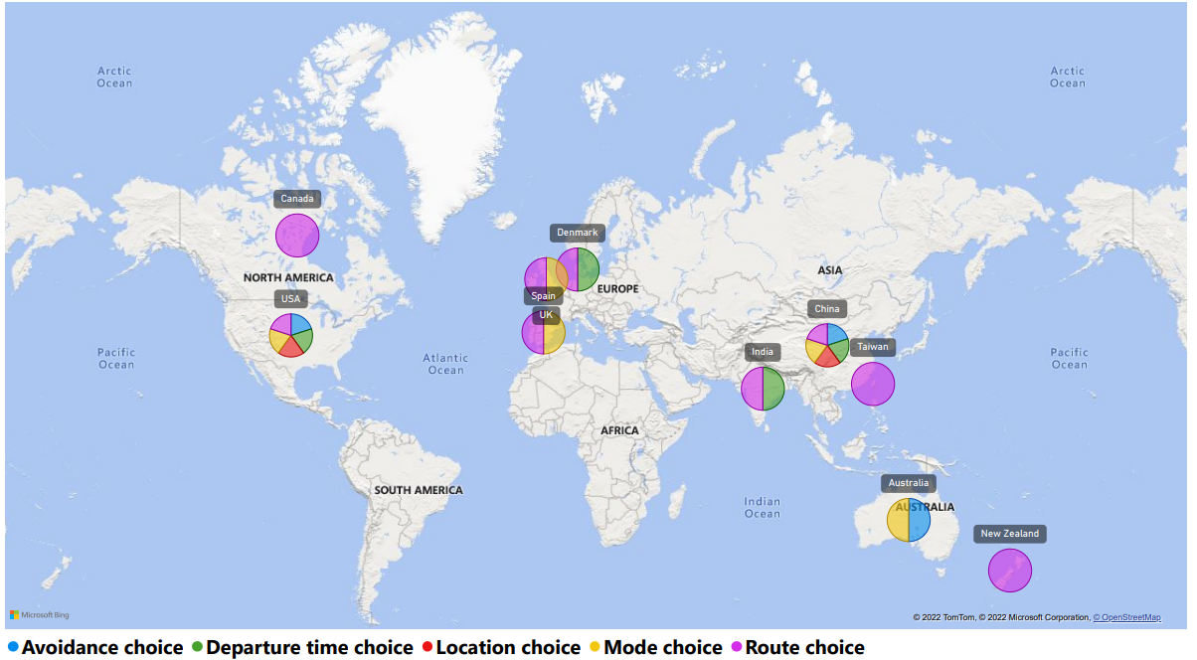
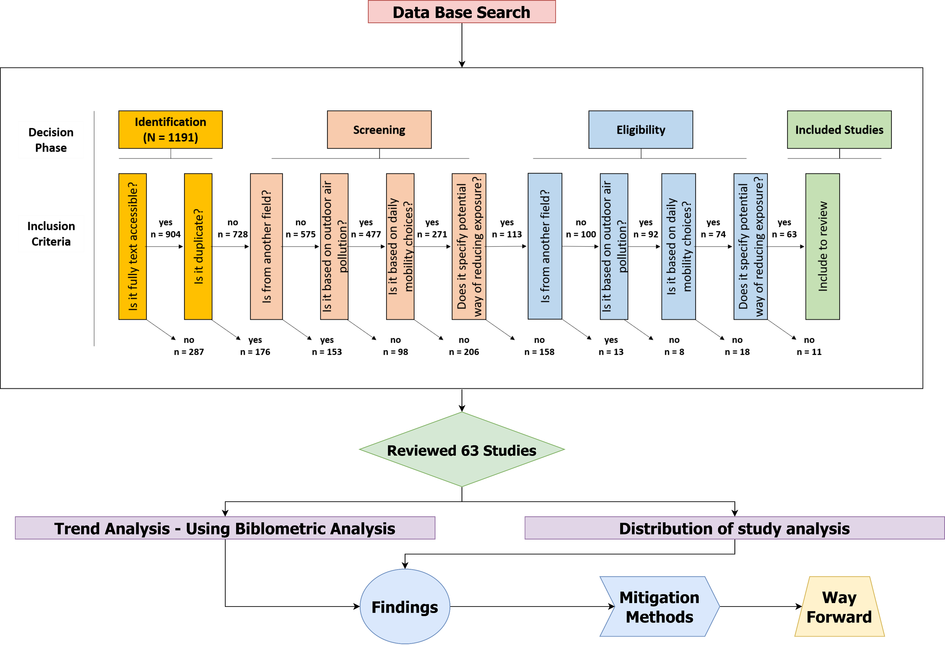
Objective – 1.1 (cont.)
Key Research Questions
majority of the research in this arena has been carried out in the USA and China
Fig: Systematic screening of literature. (Image Source: Author).
Indian Institute of Technology Kharagpur, India

Slide 12
Objective – 1.1 (cont.)
Mode choice
Route choice
Avoidance choice
Departure time choice
Key Research Questions
Maximum behavior change seen in route shifts
Awareness about AQI and its real-time pre-trip information plays a vital role in lowering commuters’ air pollution exposure.
Indian Institute of Technology Kharagpur, India

Slide 13



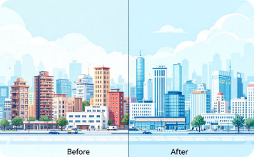

Objective – 1.2 (Panel Data Framework)
What is Panel Data?
Longitudinal Tracking
Within-Person Change
Controls for Unobserved Factors
Repeated measurements from the same respondents across multiple time points (waves).
Crucial for estimating individual changes, controlling for unobserved differences.
By observing the same entities over time, panel data helps account for time-invariant unobserved characteristics, reducing bias in estimates.
Enables Policy Evaluation
Captures Dynamic Processes
Panel data allows for precise evaluation of policy interventions and program impacts by comparing outcomes before and after implementation for the same subjects.
It provides unique insights into how phenomena evolve, change, and interact over time, enabling the study of dynamic relationships and lagged effects.
Indian Institute of Technology Kharagpur, India

Slide 14

Objective – 1.2 (Panel Data Framework)
Key Challenges in the Indian Urban Context
Respondent Recontact
Precise Geolocation Absence
Standard survey tools like Google Forms often lack the capability to capture accurate latitude/longitude coordinates at the exact interview location.
High urban mobility, frequent SIM card changes, and informal addresses make recontacting the same person across waves extremely difficult.
Brittle Matching Across Waves
Operational Complexities
Managing multilingual scripts, ensuring data privacy and consent, and accommodating device variability in the field add layers of complexity.
Without reliable geotags and unique Panel IDs, linking data from the same respondent across different waves becomes highly error-prone and unreliable.
Indian Institute of Technology Kharagpur, India

Slide 15
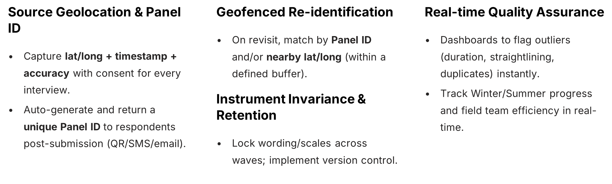
Objective – 1.2 (Panel Data Framework)
Overcoming Challenges: Our Approach
Key Research Questions
Indian Institute of Technology Kharagpur, India

Slide 16
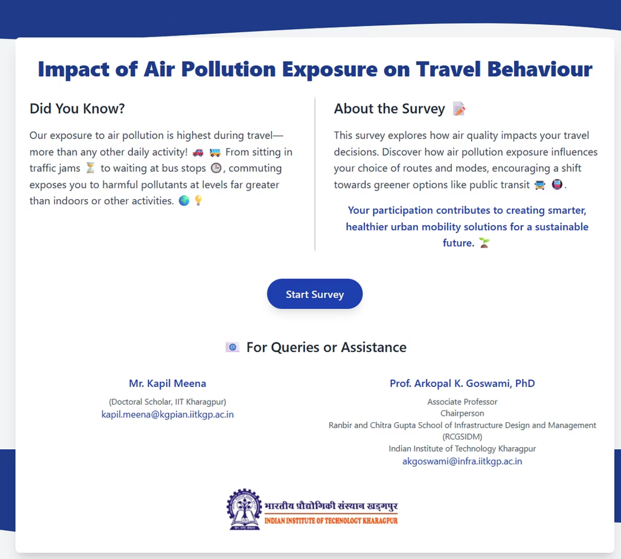



In-House Survey Platform
Designed for Panel Data Survey
Code Repo: https://github.com/kapil2020/react-frontend-kgp
Survey link: https://survey-iitkgp.vercel.app/
Real-time response link: https://survey-iitkgp.vercel.app/responses

Slide 17
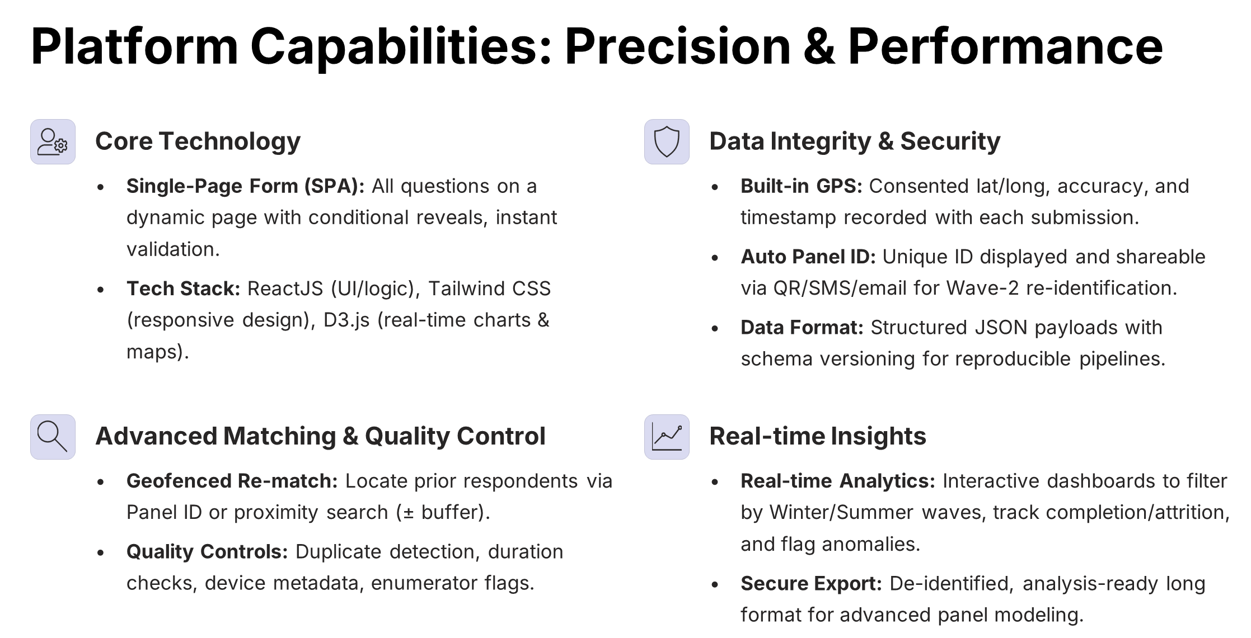
Objective – 1.3 (Survey Tool)
Key Research Questions
Indian Institute of Technology Kharagpur, India

Slide 18
Objective – 1.3 (Survey Tool)
Panel Survey Methodology
Key Research Questions
01
02
Sampling & Onboarding
Wave 1: Winter Data Collection
Define strata, recruit respondents, obtain consent, assign unique Panel IDs.
Collect socio-demographic, health, AQI awareness, and travel diary data. Record lat/long at interview site and return Panel ID to respondent.
03
04
Wave 2: Summer Data Collection
Linkage & Validation
Re-identify respondents via Panel ID or geofence. Replicate the instrument for comparability.
Join Winter and Summer data using Panel ID + time/location stamps. Conduct consistency checks and de-identification.
Indian Institute of Technology Kharagpur, India

Slide 19
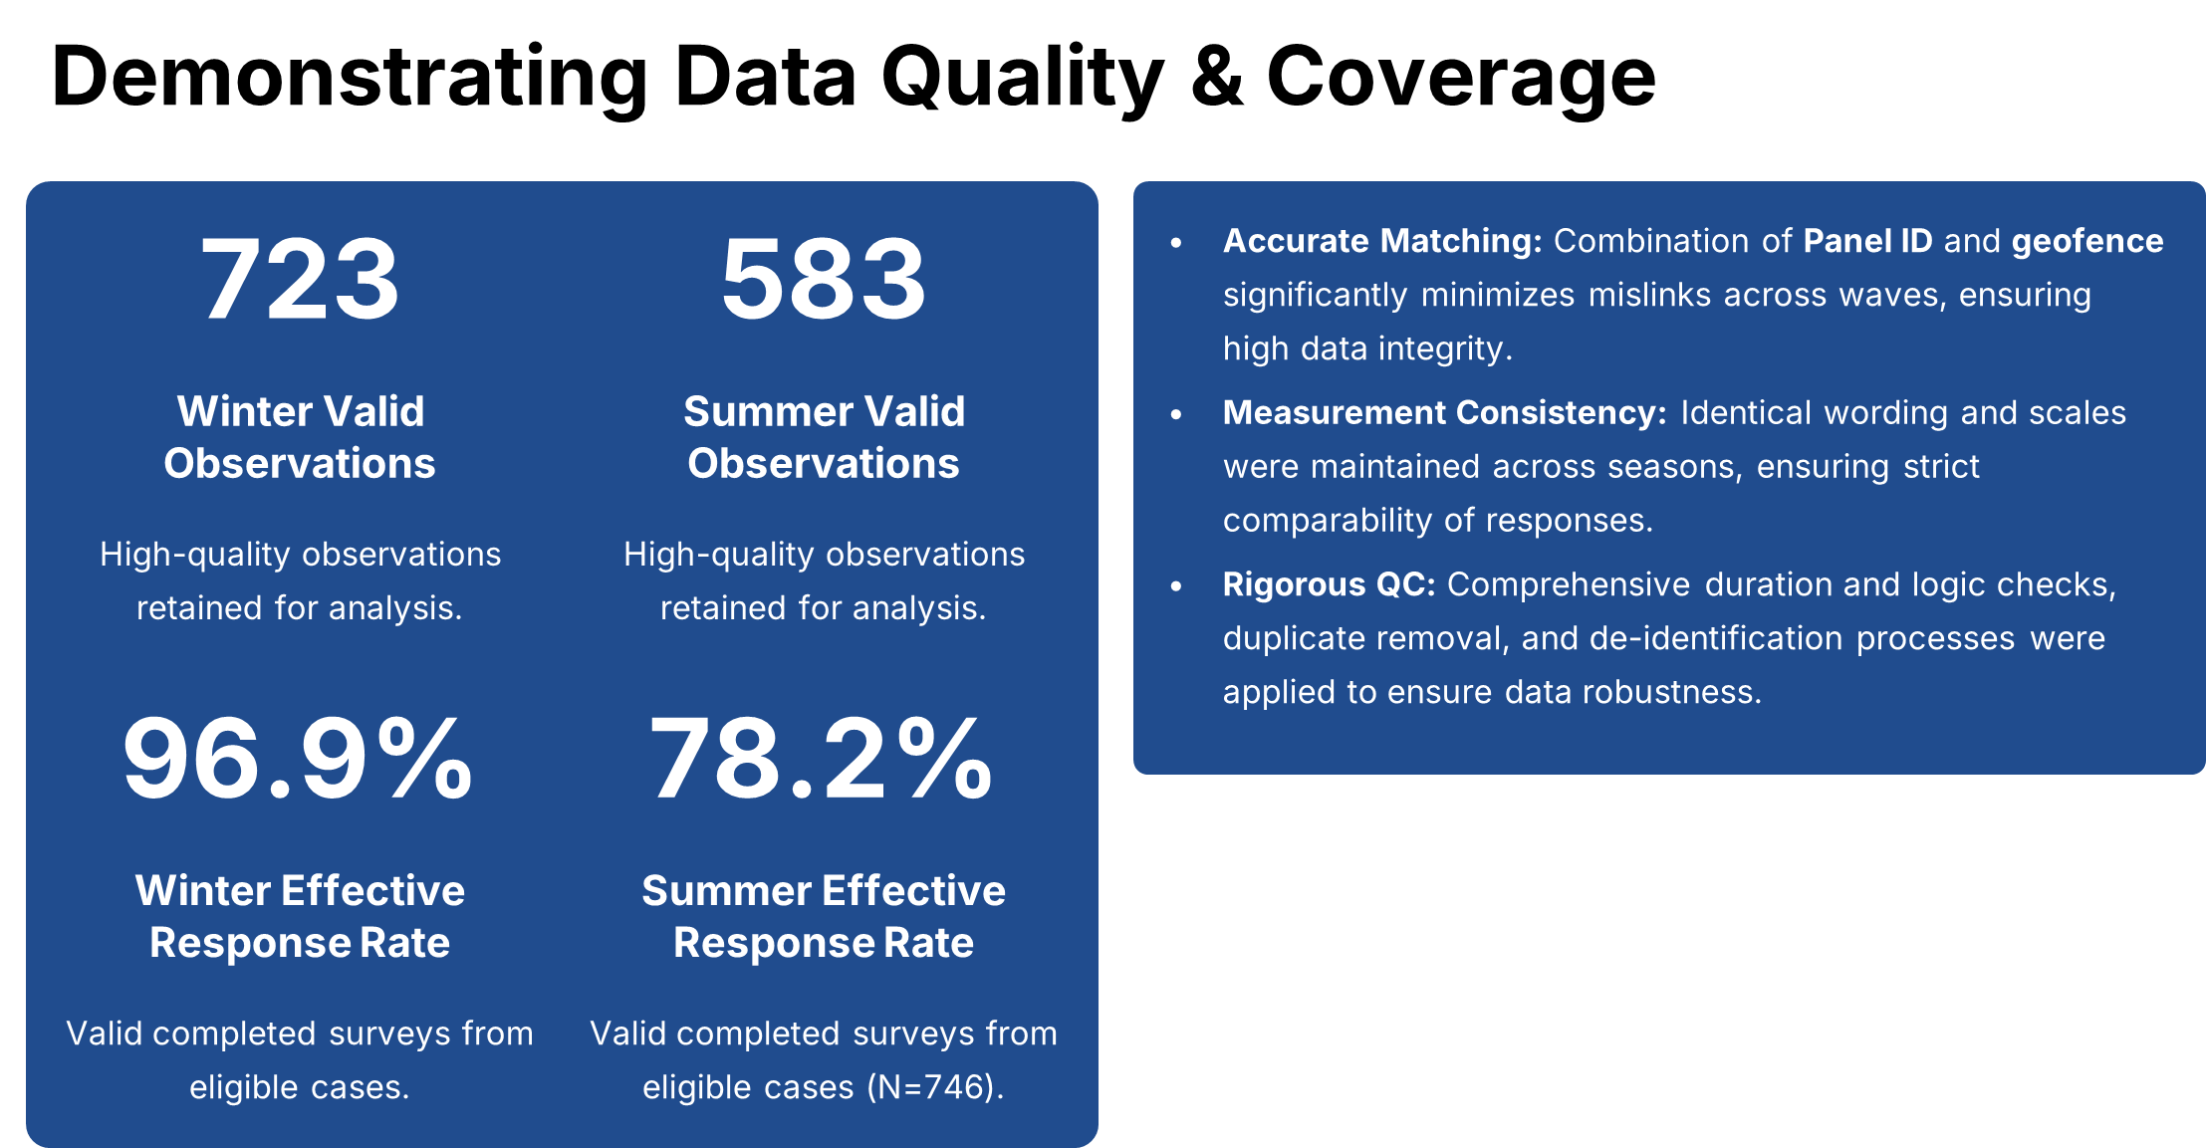
Objective – 1.3 (Survey Tool)
Key Research Questions
Indian Institute of Technology Kharagpur, India

Slide 20
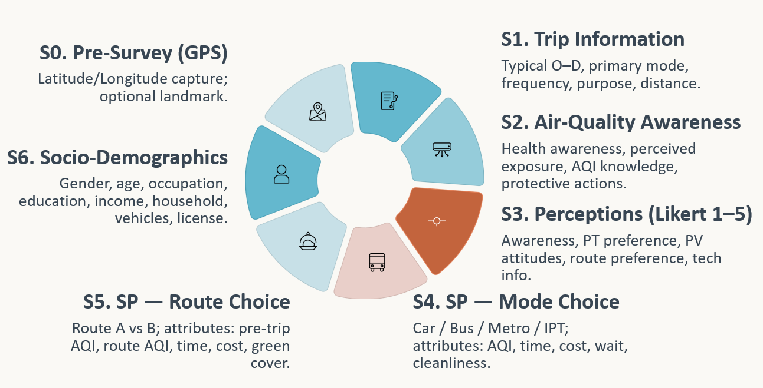
Objective – 1.4 (Survey Design)
RP-Survey
Key Research Questions
SP-Survey
Indian Institute of Technology Kharagpur, India

Slide 21
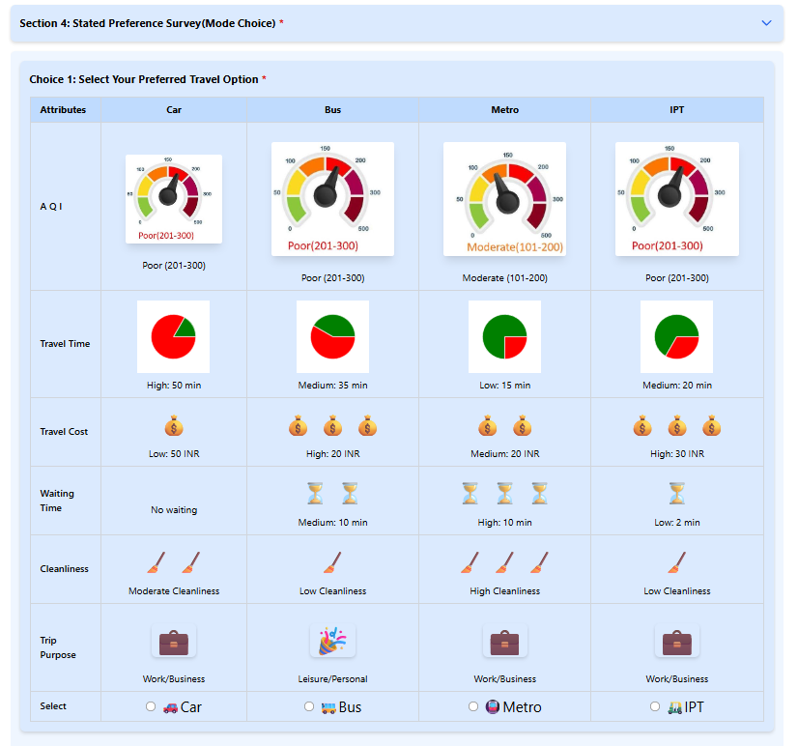
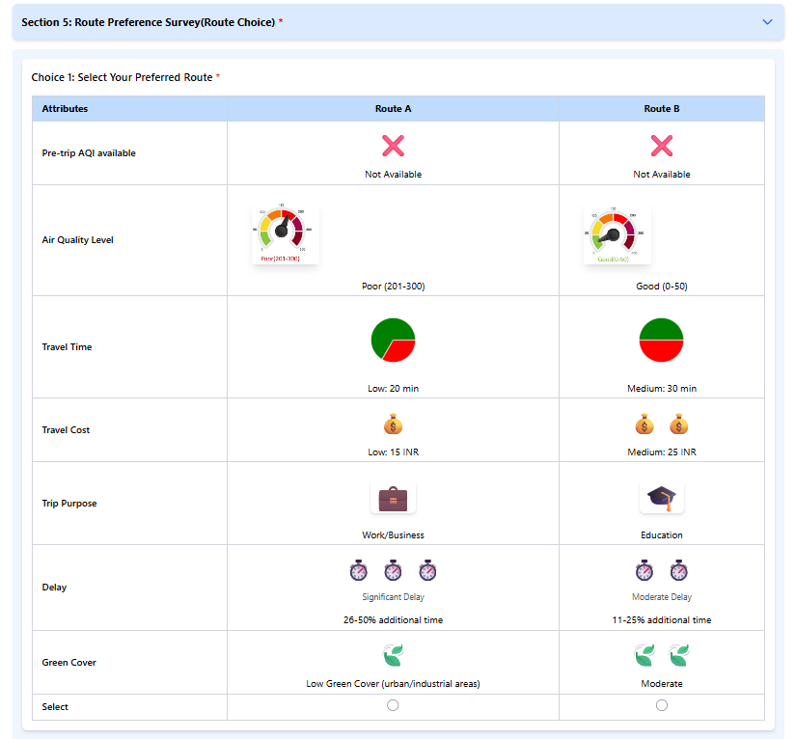
Objective – 1.4 (Survey Design)
Mode Choice Survey
Route Choice Survey
Key Research Questions
Indian Institute of Technology Kharagpur, India

Slide 22
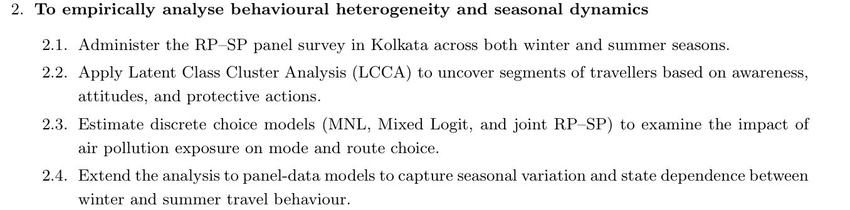

Objective – 2 – Data analysis; Latent class cluster analysis; mode choice
Key Research Questions
Meena, K.K., and A.K. Goswami (2026). “Not all travellers think alike: Segmenting travel behaviour under air pollution exposure using a hybrid latent class and discrete choice approach.” Submitted to the Transportation Research Board (TRB) 2026 Annual Meeting, Washington, DC
Indian Institute of Technology Kharagpur, India

Slide 23
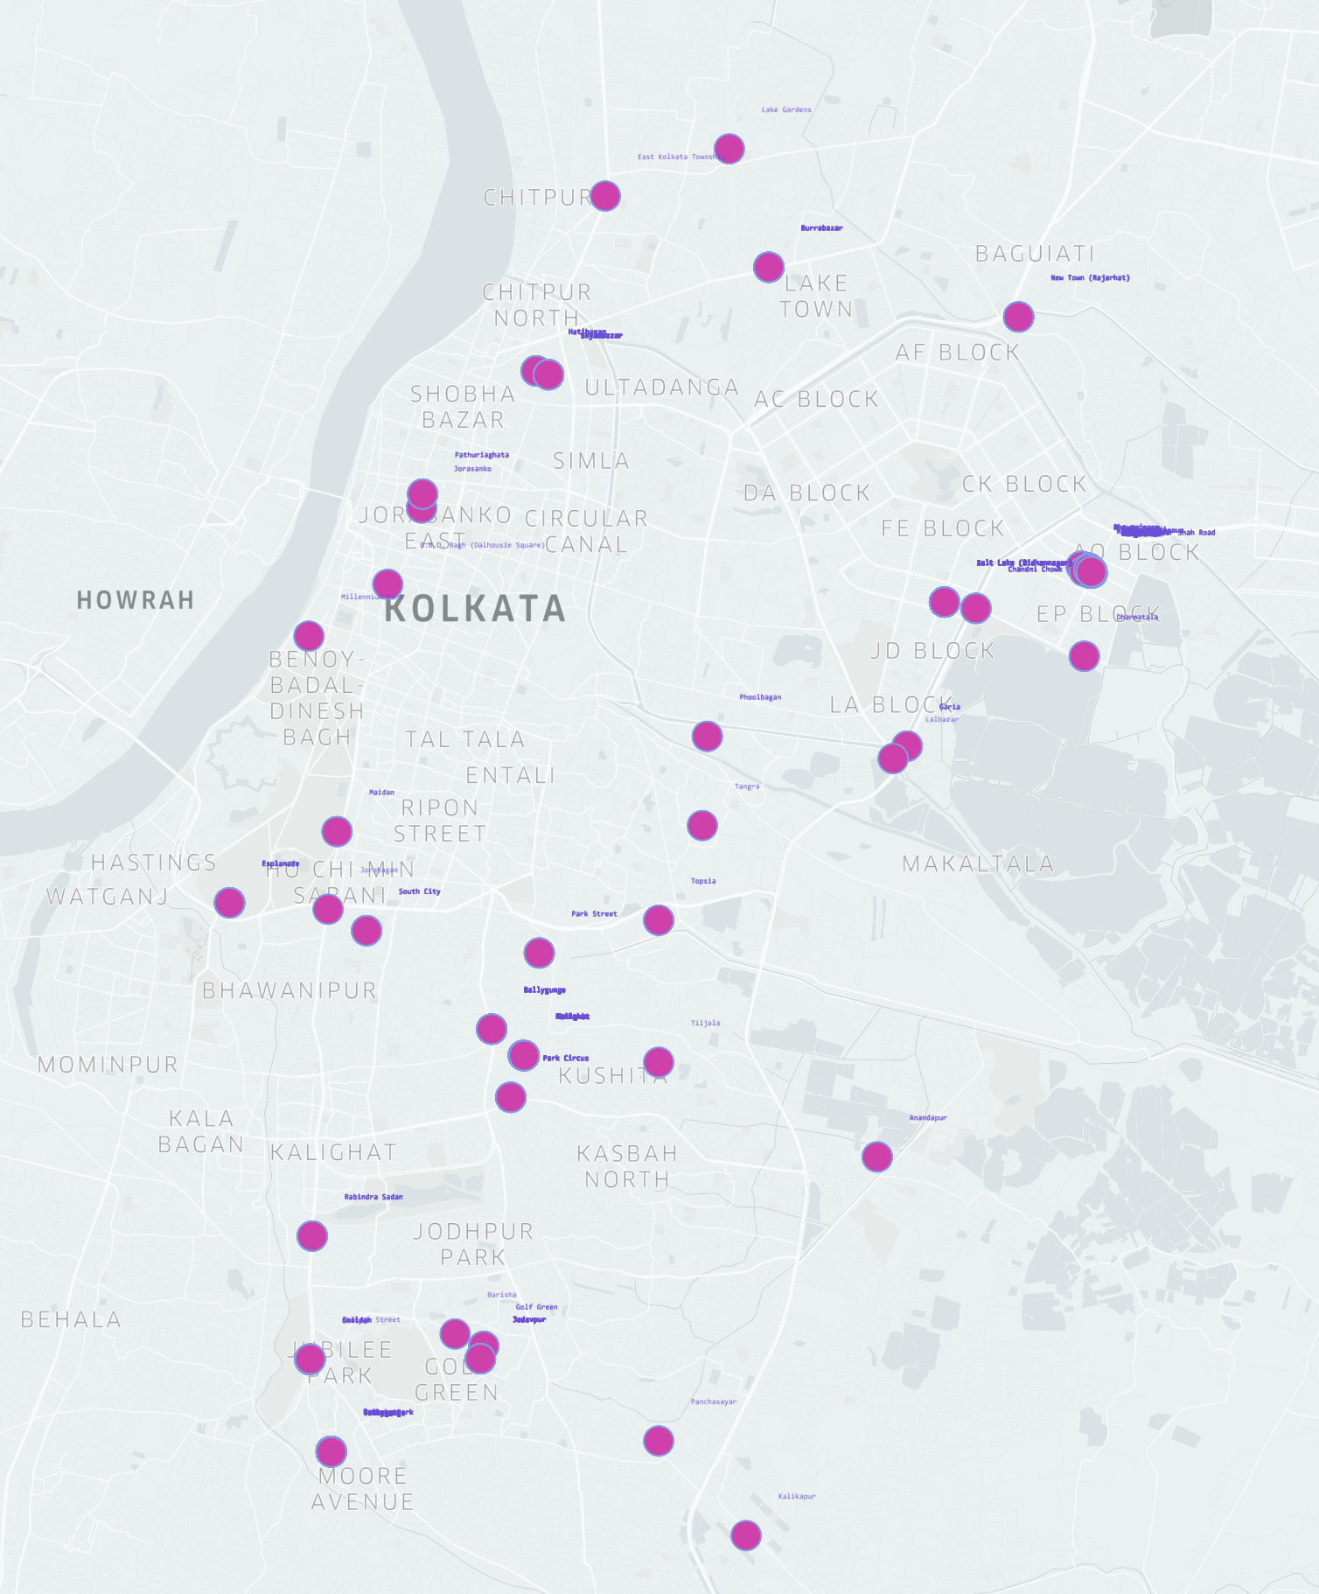
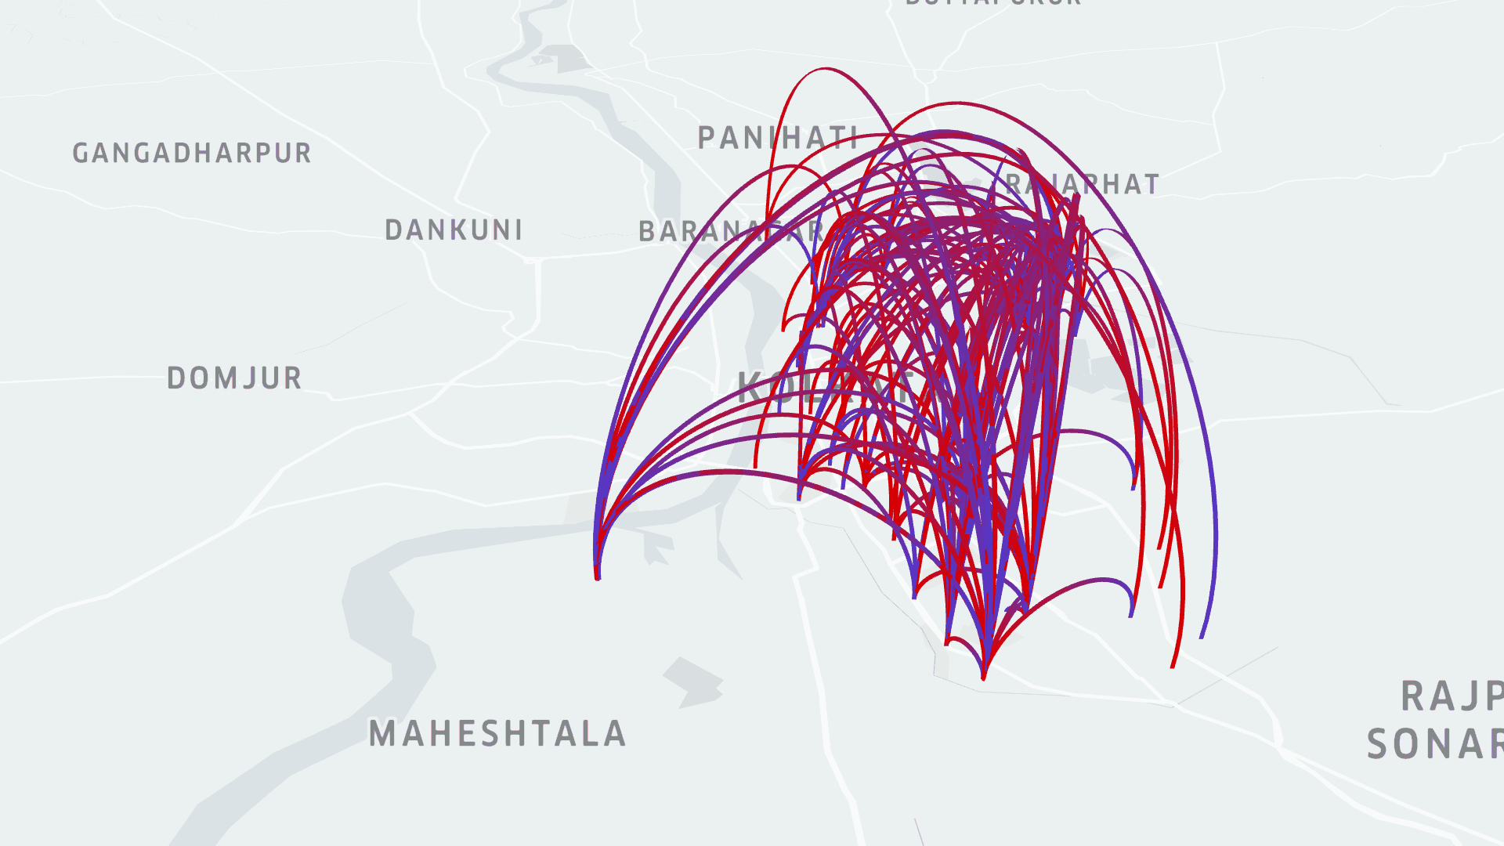
Objective – 2 – Data analysis; Latent class cluster analysis; mode choice
Key Research Questions
Indian Institute of Technology Kharagpur, India

Slide 24
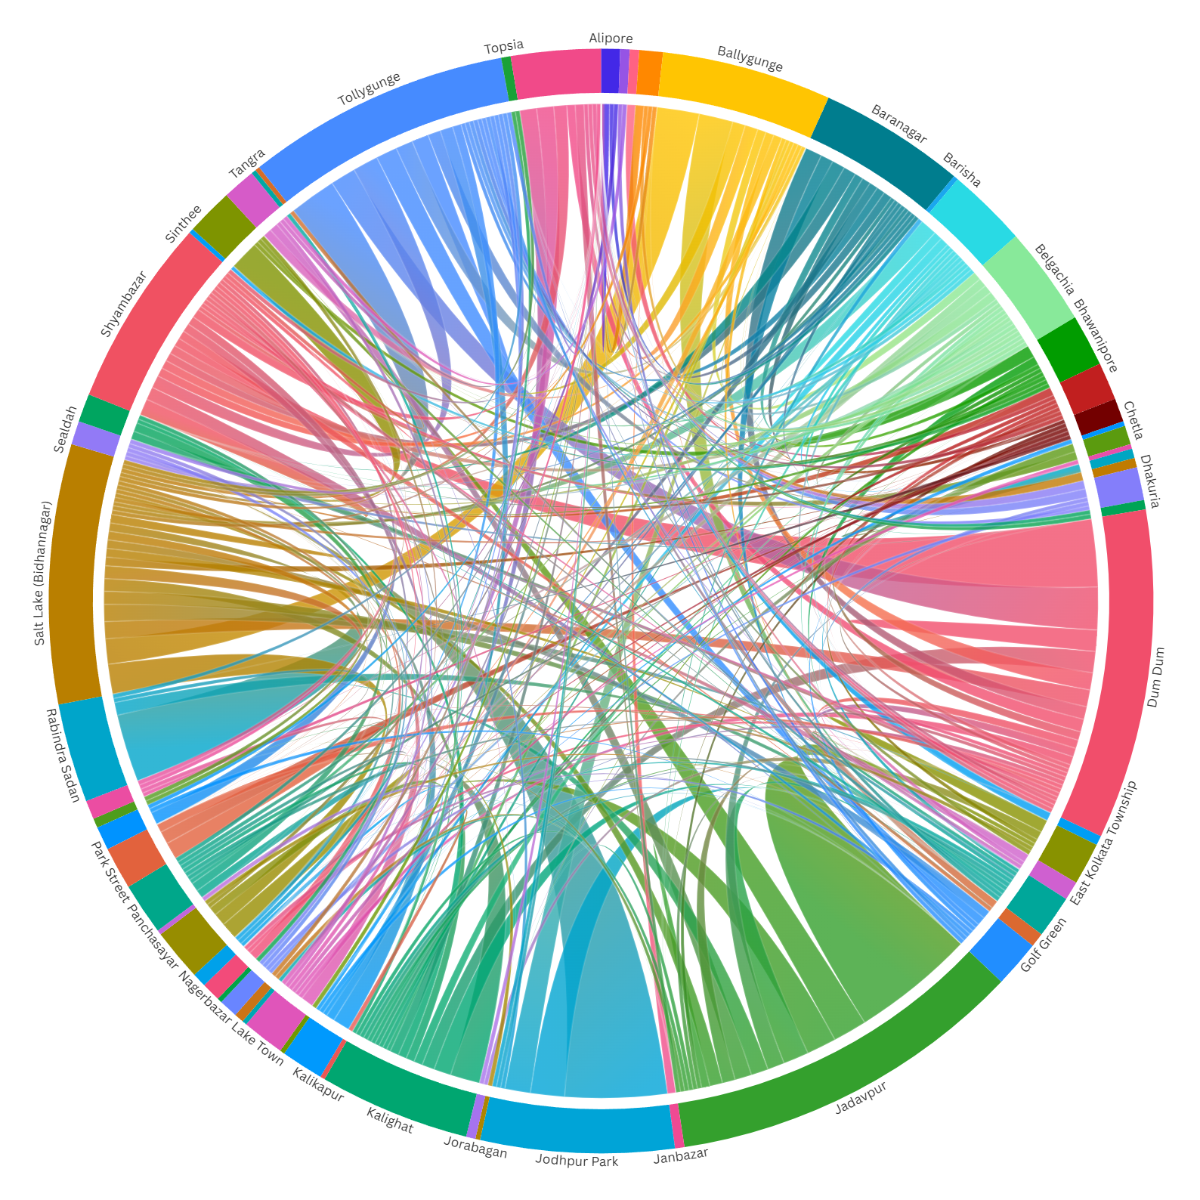
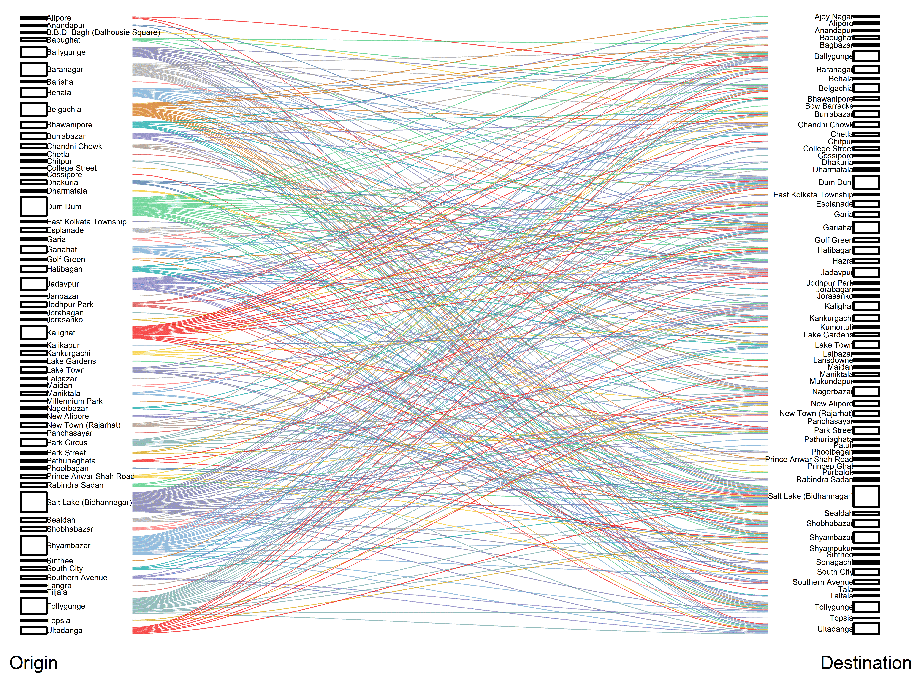
Objective – 2 – Data analysis; Latent class cluster analysis; mode choice
Key Research Questions
Indian Institute of Technology Kharagpur, India

Slide 25
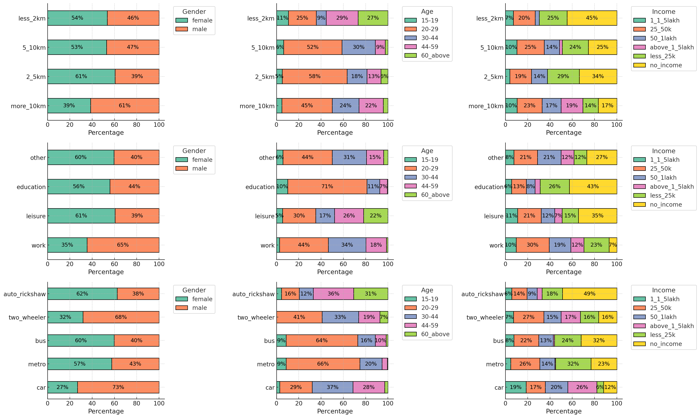
Objective – 2 – Data analysis; Latent class cluster analysis; mode choice
Key Research Questions
Short Trips (<5 km):
🚶‍♀️ Female majority
🚌 Bus / 🚇 Metro / 🚖 Auto
🪙 More low-income / no-income
Long Trips (>10 km):
🚶‍♂️ Male majority
🚗 Car / 🏍 Two-Wheeler
💰 Higher-income
Work Trips:
💼 Male
🚗 Car / 🏍 Two-Wheeler
Education & Leisure Trips:
🚶‍♀️ Female
🚌 Bus / 🚇 Metro / 🚖 Auto

Slide 26
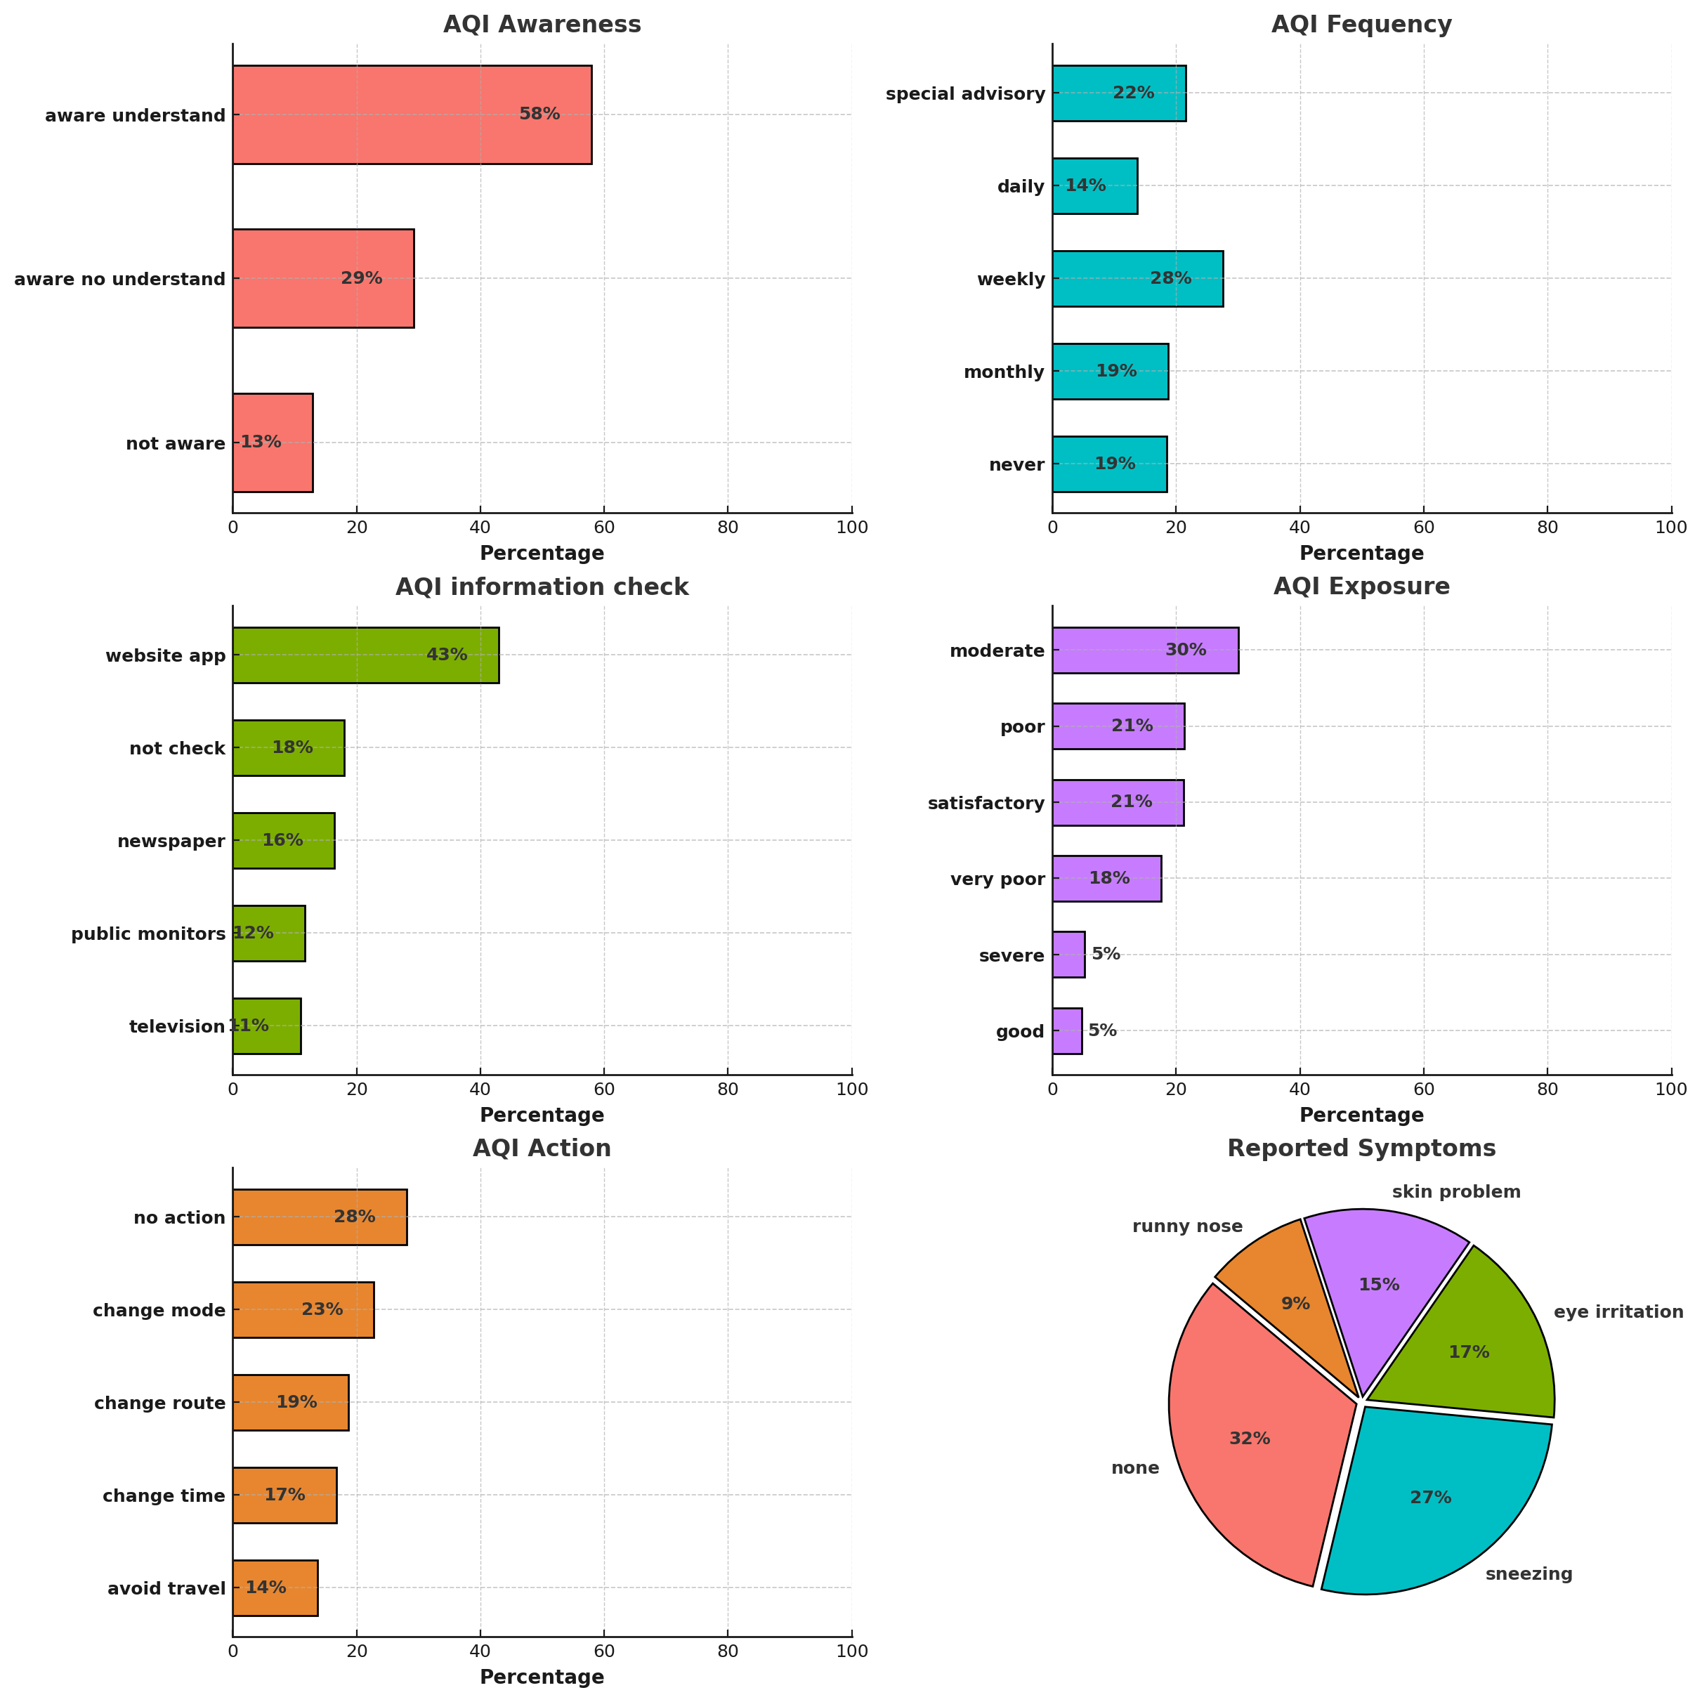
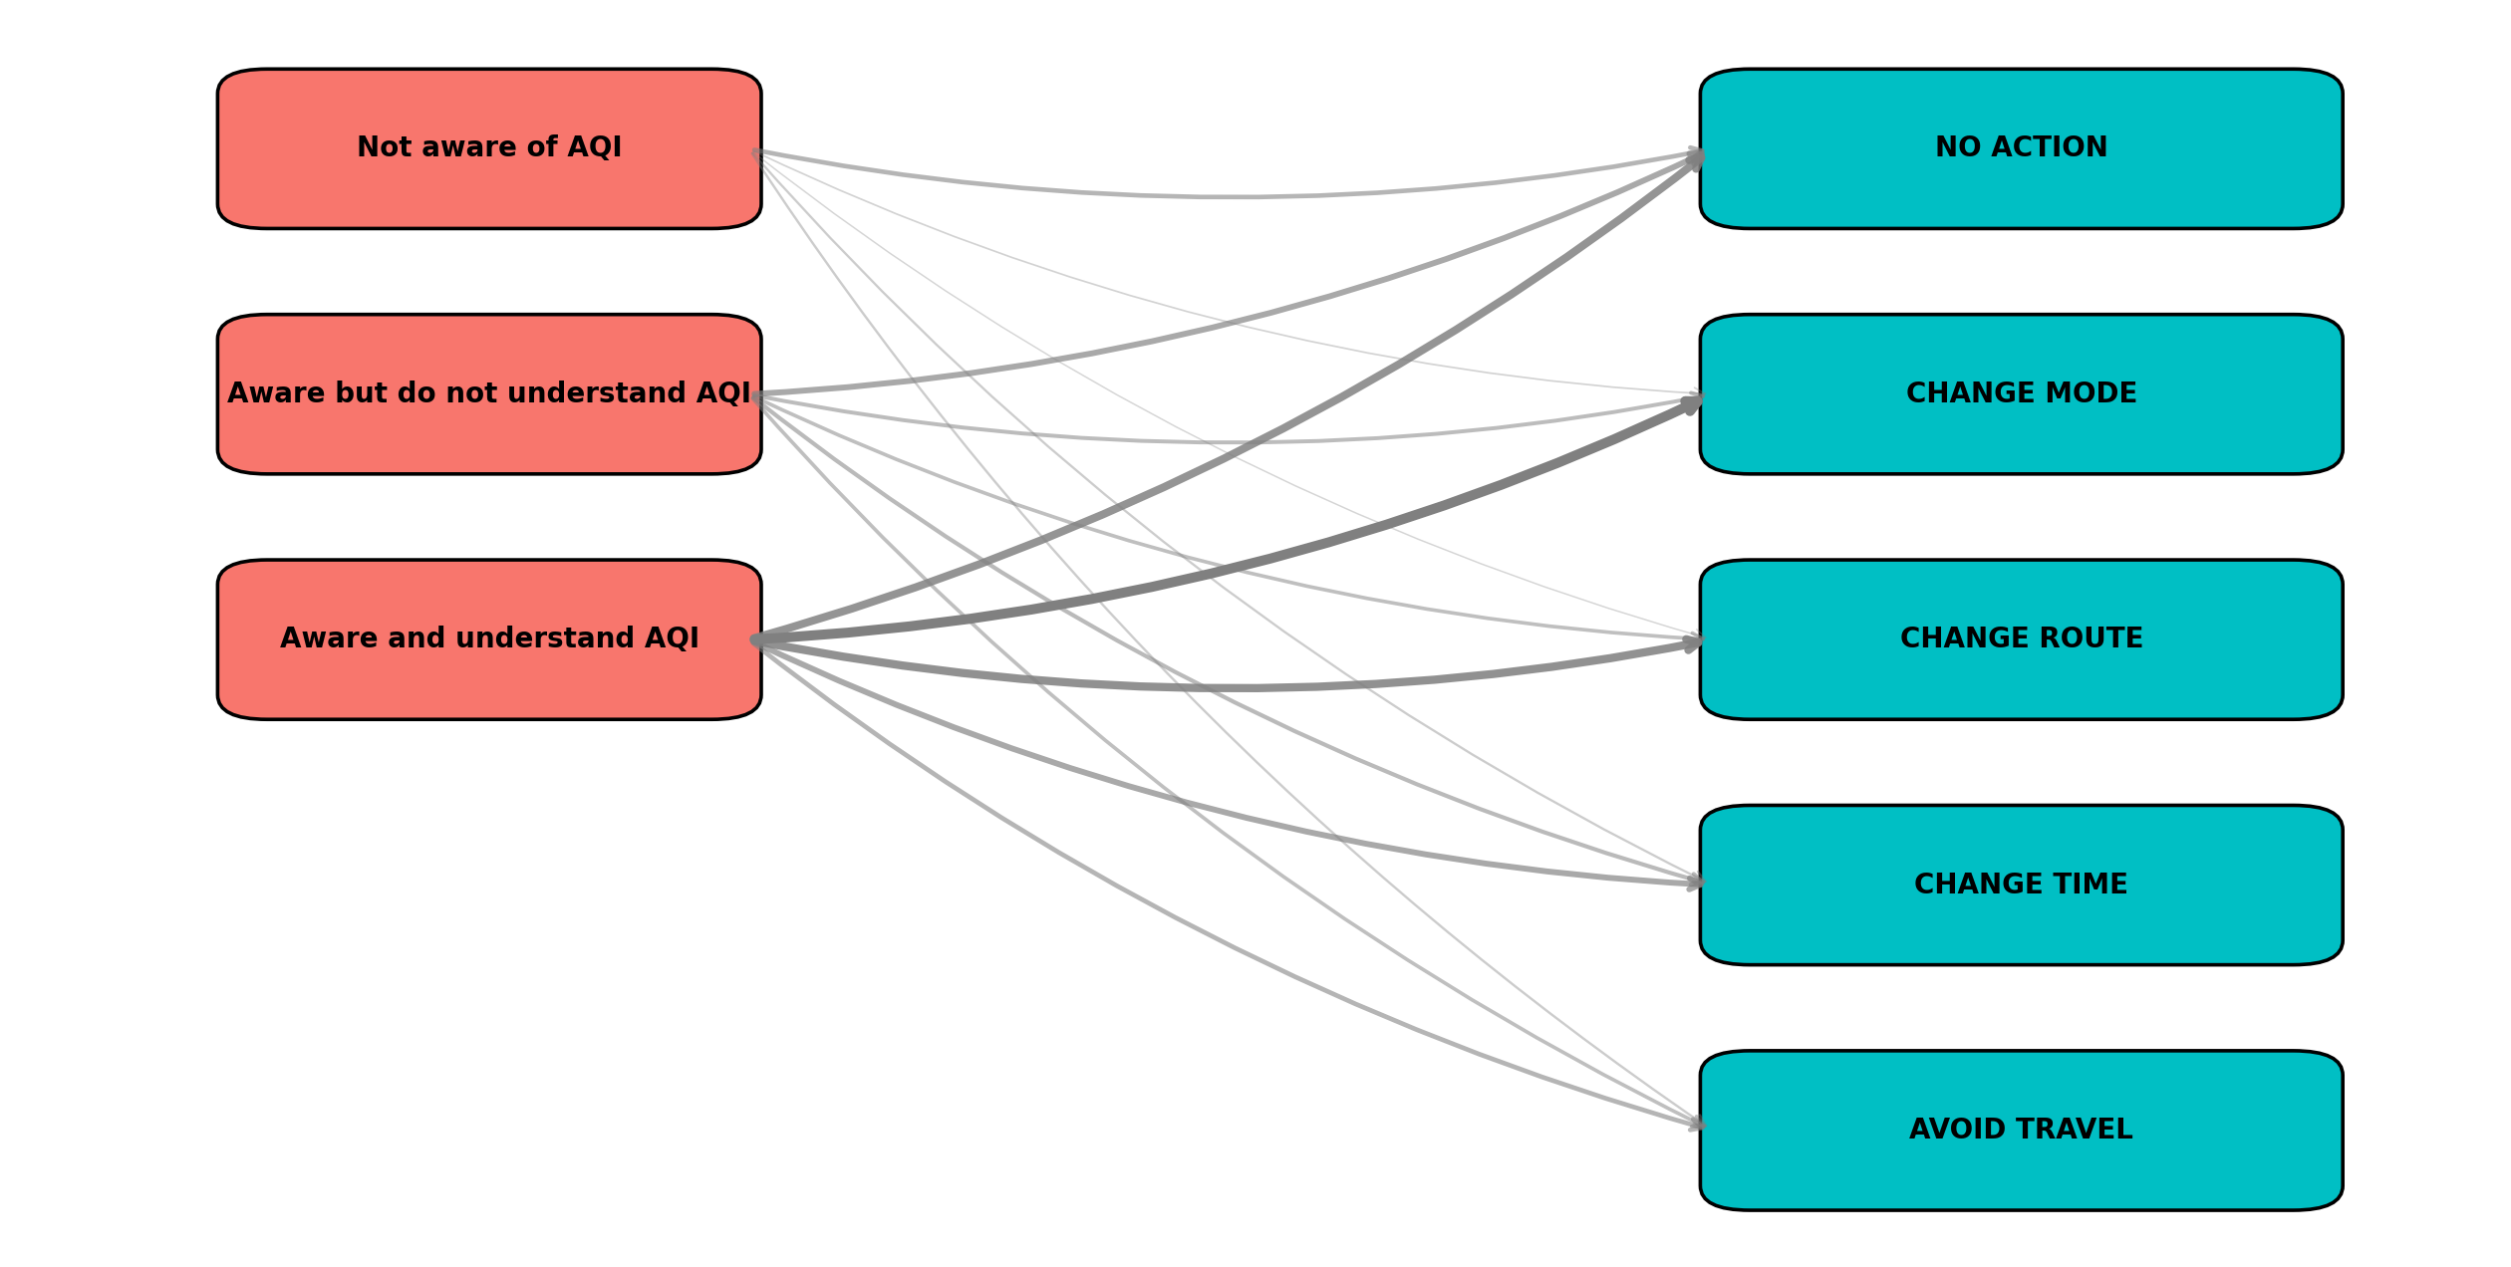
Objective – 2 – Data analysis; Latent class cluster analysis; mode choice
Key Research Questions
⚠️ Awareness–Action Gap: While 58% understand AQI, almost 1 in 3 still take no protective action.
📱 Digital Dependence: AQI checks are dominated by apps/websites (43%), far more than traditional sources (TV/newspaper <20%).
📅 Reactive, not proactive: People check AQI weekly (28%) or only during advisories (22%), showing limited daily engagement.
🚶 Behavioral adaptation is selective: Mode shift (23%) is the top protective action, while avoiding travel (14%) is least preferred.
🤧 Health Impact: 32% report no symptoms; common issues = sneezing (27%) & eye irritation (17%).

Slide 27
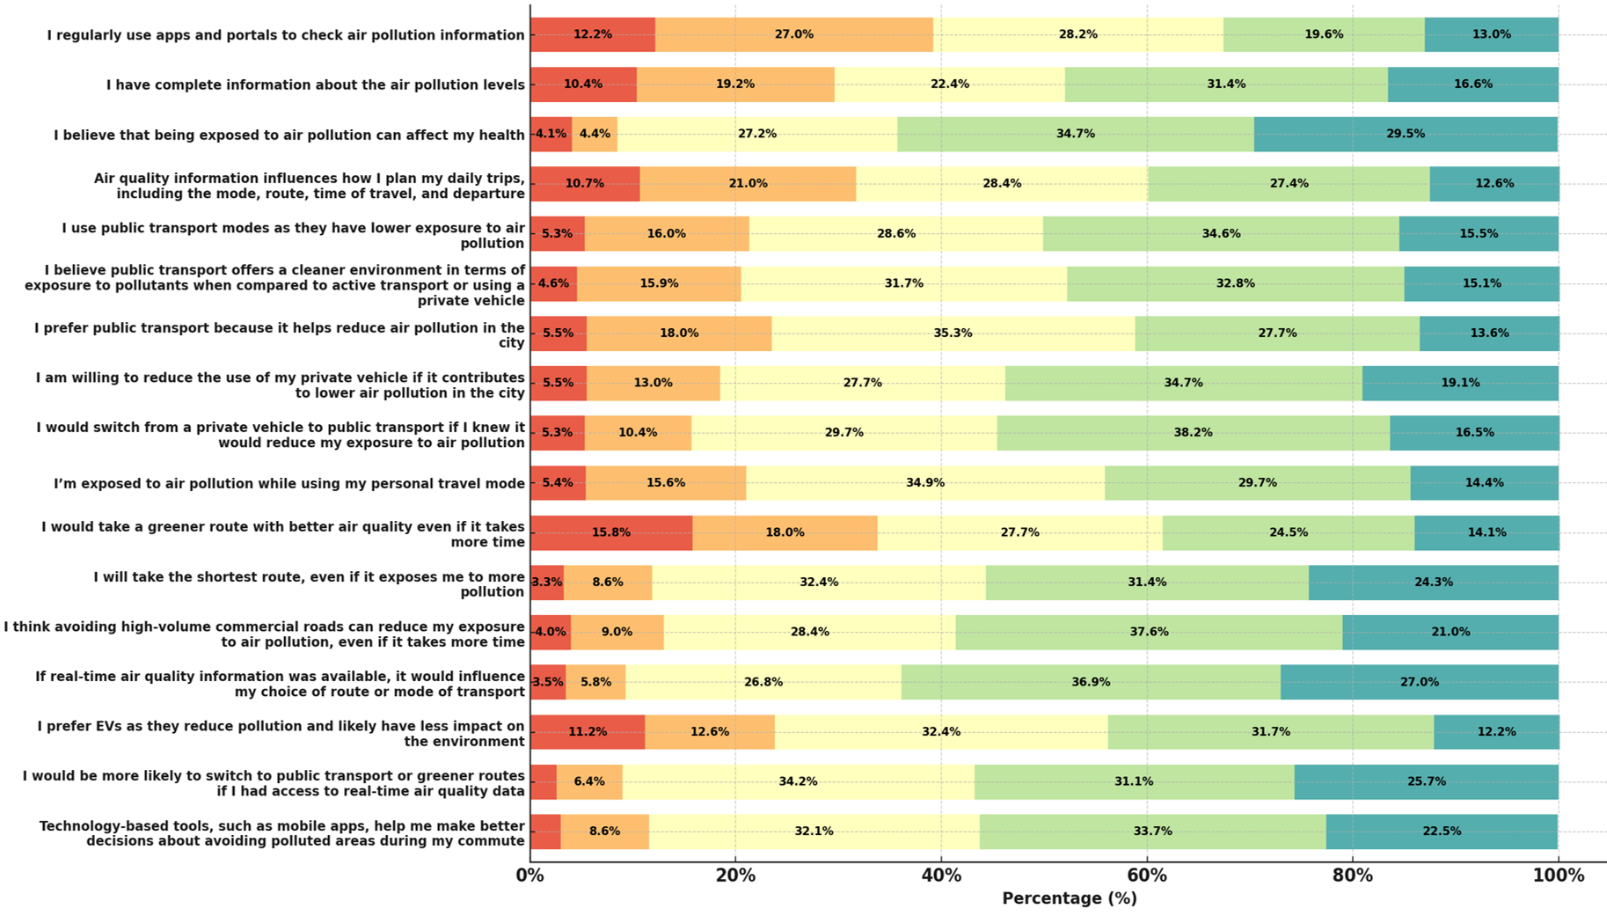
Objective – 2 – Data analysis; Latent class cluster analysis; mode choice
Key Research Questions
🏥 92% agree air pollution harms health → strong awareness.
🚍 80%+ see PT as cleaner & city-friendly.
📱 Real-time AQI/apps (83%) = biggest behavior trigger.
🌱 2 in 3 prefer cleaner routes over faster ones.
🚗 Car users know risks but resist change → behavior gap.

Slide 28
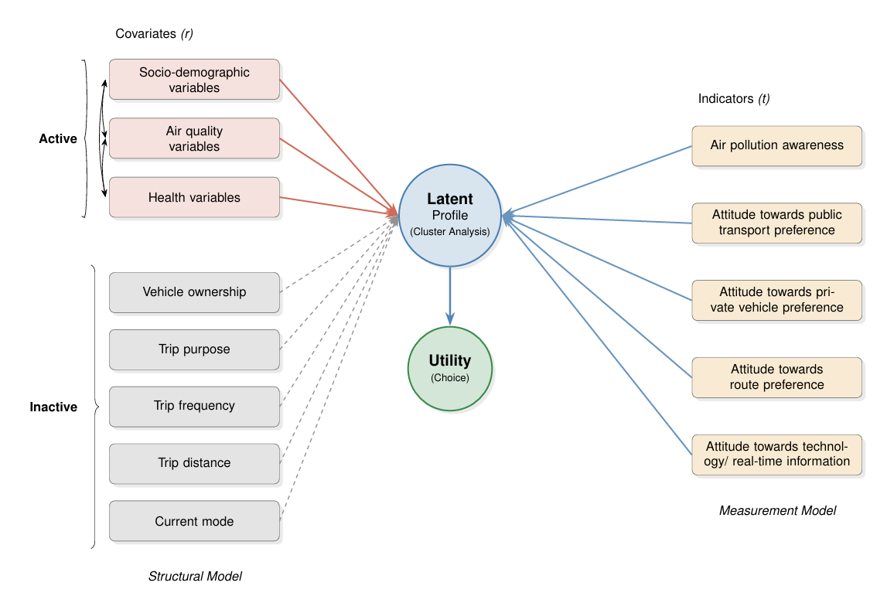
Objective – 2 – Data analysis; Latent class cluster analysis; mode choice
Key Research Questions

Slide 29
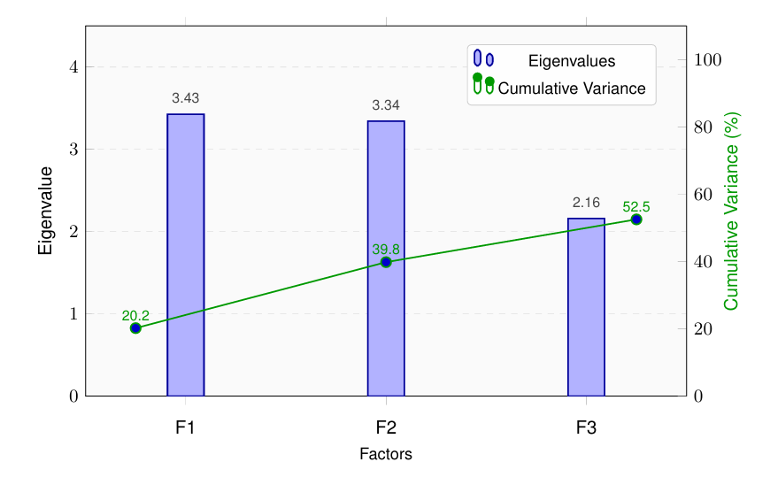
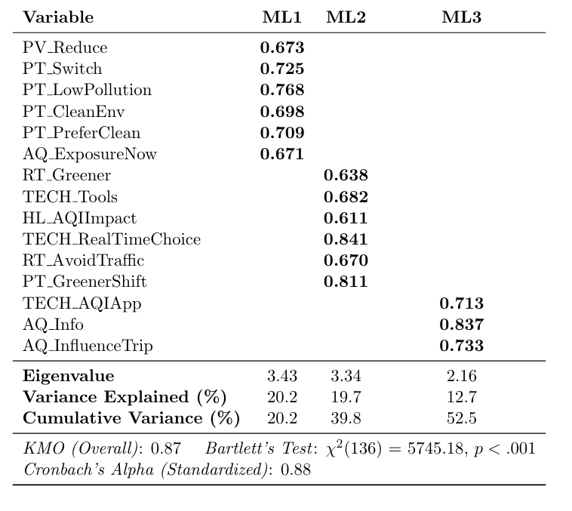
Objective – 2 – Data analysis; Latent class cluster analysis; mode choice
Key Research Questions
ML1
Perceived Value & Env. Behavior
ML2
Real-Time Info & Tech Use
ML3
AQI Info Seeking

Slide 30
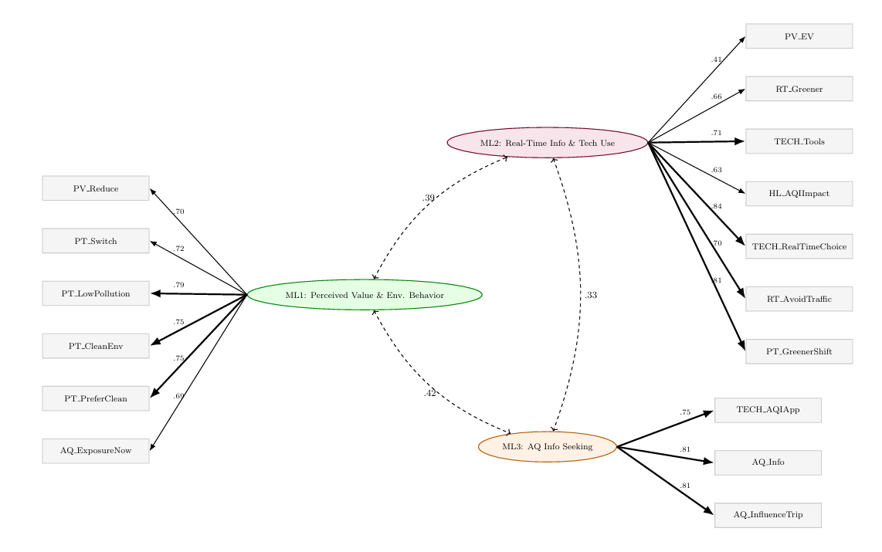
Objective – 2 – Data analysis; Latent class cluster analysis; mode choice
Key Research Questions

Slide 31
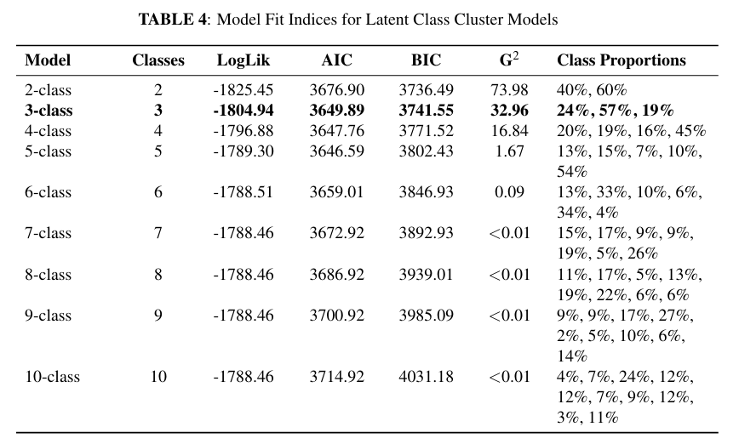
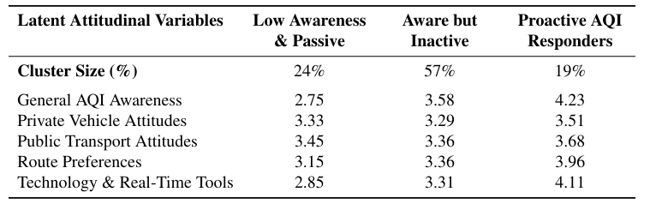
Objective – 2 – Data analysis; Latent class cluster analysis; mode choice
Key Research Questions

Slide 32
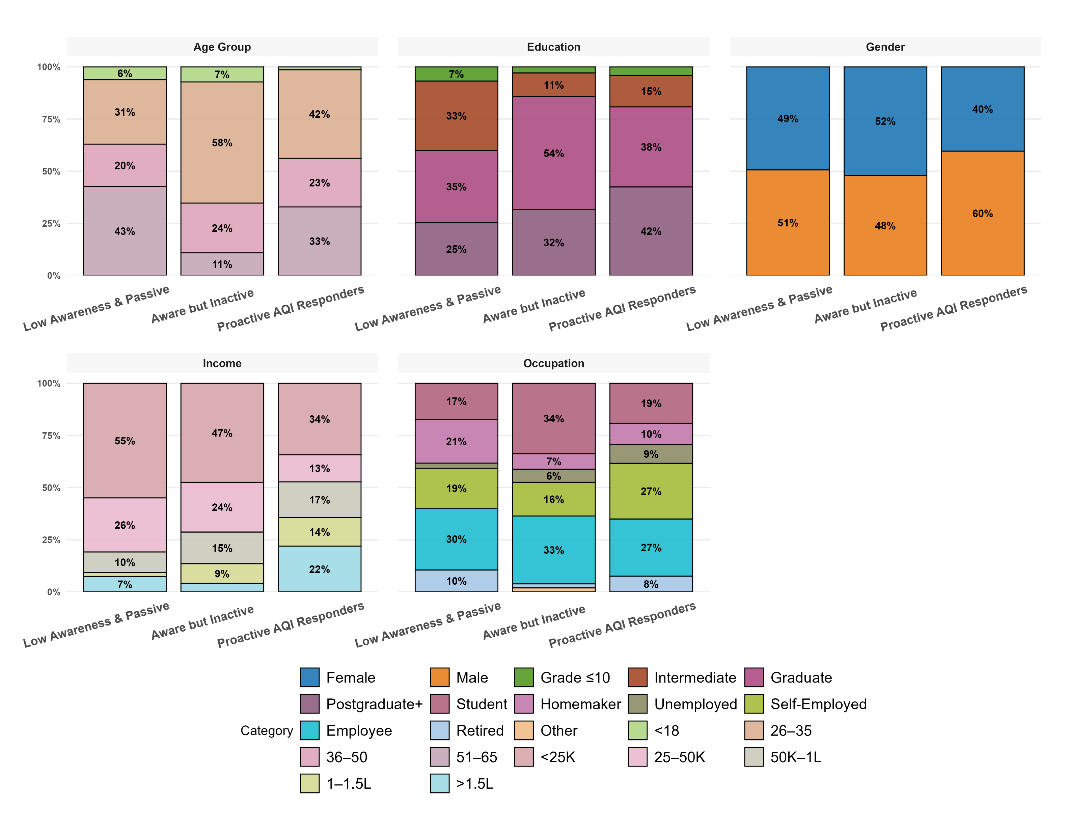
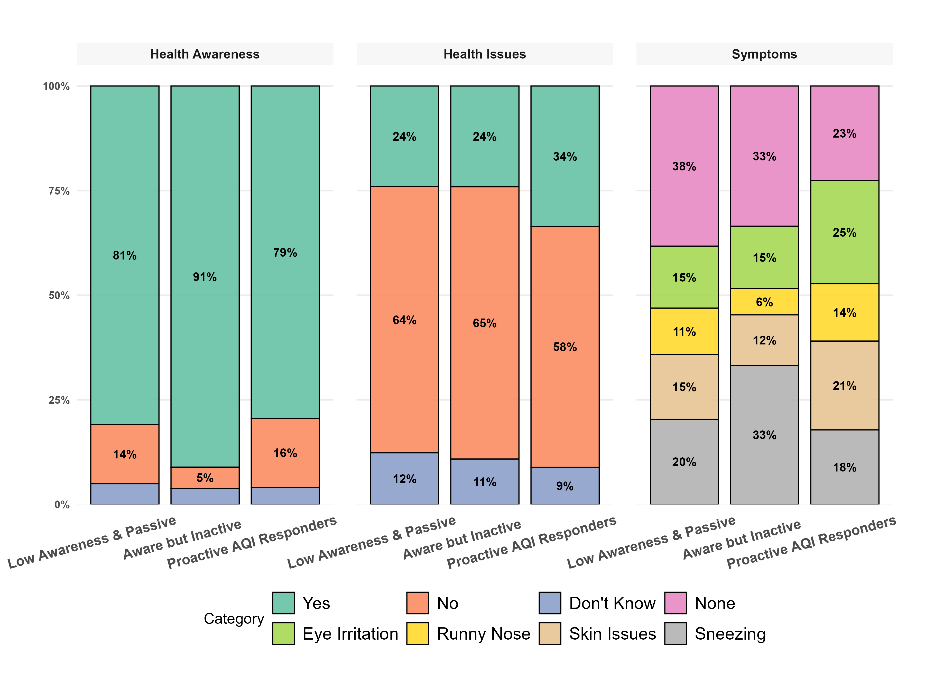
Objective – 2 – Data analysis; Latent class cluster analysis; mode choice
👶➡️👨 Proactive AQI responders skew younger (26–35: 42%), while passive groups are older (36–50: 43%).
🎓 Higher education drives action — graduates & postgrads dominate proactive group (42%+).
👩‍🦰👨 Men (60%) are more proactive, while women lean toward passive/aware-but-inactive.
💰 Higher-income (>1L) households (22%) are more proactive, while low-income (<25K: 55%) remain passive.
💼 Employees & self-employed (54%) lead proactive action, vs. homemakers/retired clustered in passive groups.
Key Research Questions

Slide 33
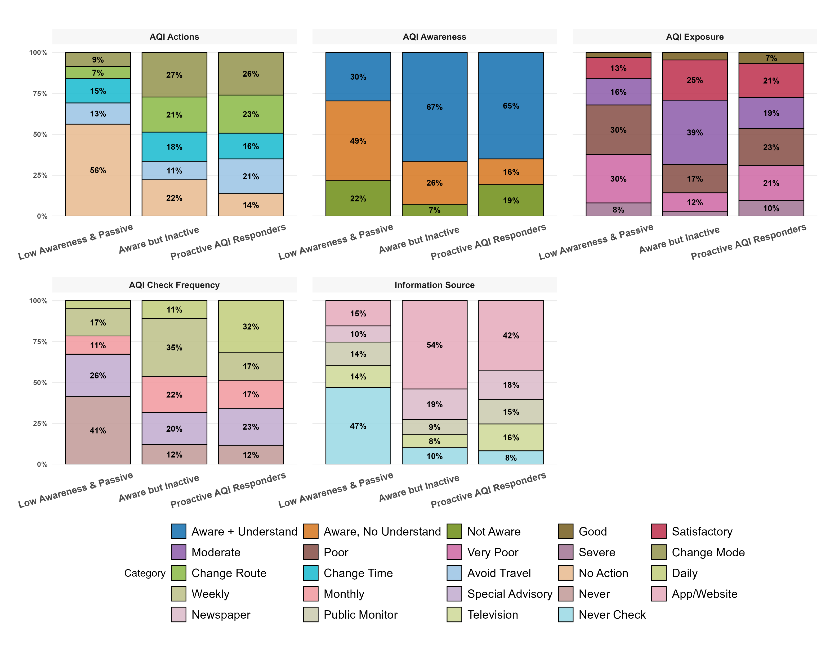
Objective – 2 – Data analysis; Latent class cluster analysis; mode choice
Key Research Questions
🚫 56% of passive = no action.
✅ Proactive responders diversify actions: change mode (27%), route (23%), time (21%), avoid travel (14%).
📊 Awareness high in active groups (~65–67%).
📅 Check frequency differs: passive = never/daily; proactive = weekly.
📱 Passive = rely heavily on apps (47%), proactive = apps (42%) + monitors (16%).

Slide 34
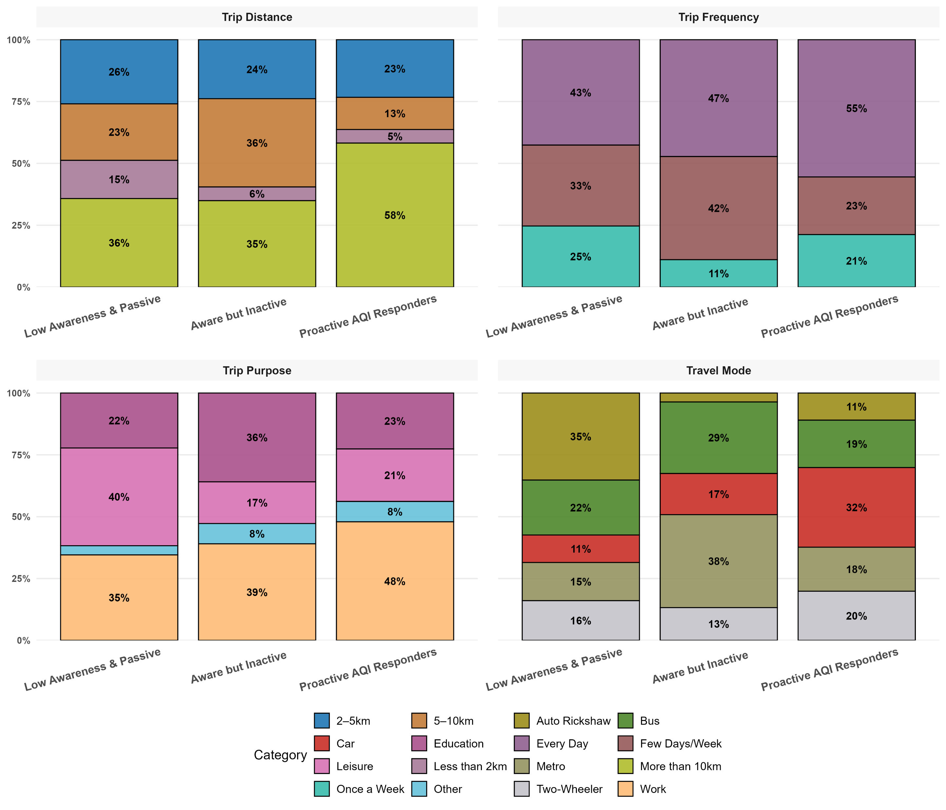
Objective – 2 – Data analysis; Latent class cluster analysis; mode choice
Key Research Questions
📏 Proactive responders take longer trips — 58% travel >10 km vs. only 35–36% in passive groups.
📅 Higher travel intensity — 55% of proactive responders travel every day, while passives are more weekly/few days.
🎓💼 Work dominates proactive trips (48%), while passive groups have more leisure/education trips (40–36%).
🚍 Proactive = more Car (32%) & Metro (20%) users, while passives lean Auto/Bus.
🔄 Storyline: Proactive groups = longer, more frequent, work-based commutes, relying on private + metro modes, while passive groups = shorter, leisure/education trips with bus/auto.

Slide 35
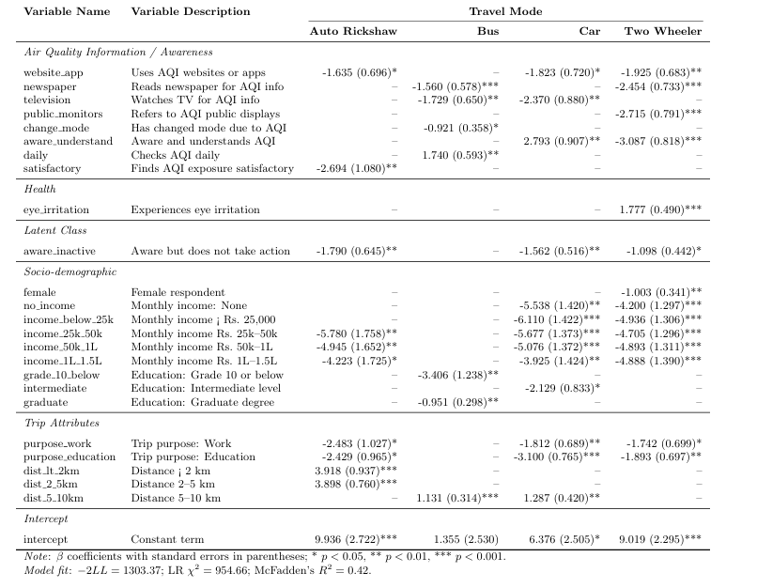
Objective – 2 – Data analysis; Latent class cluster analysis; mode choice
Key Research Questions

Slide 36
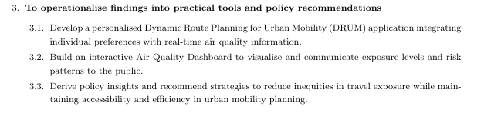
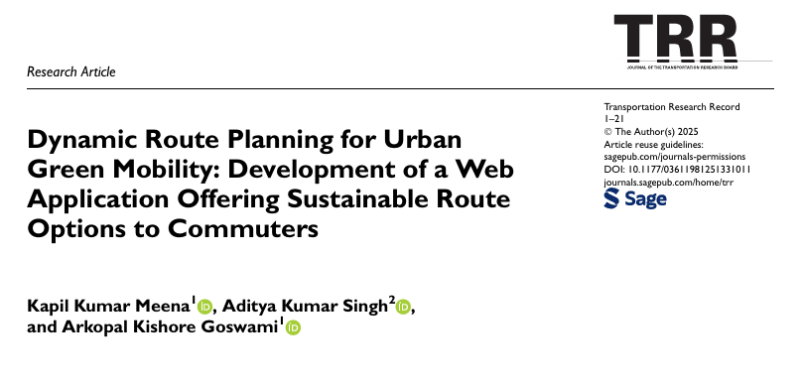
Objective – 3
Key Research Questions
Indian Institute of Technology Kharagpur, India

Slide 37
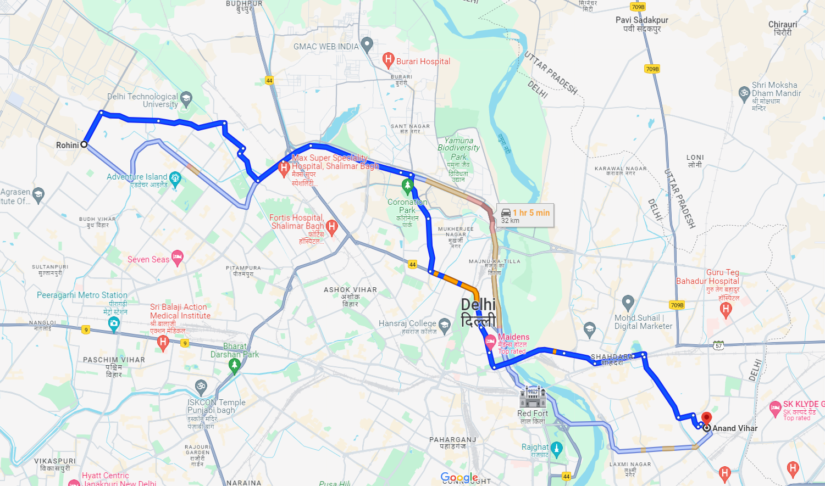
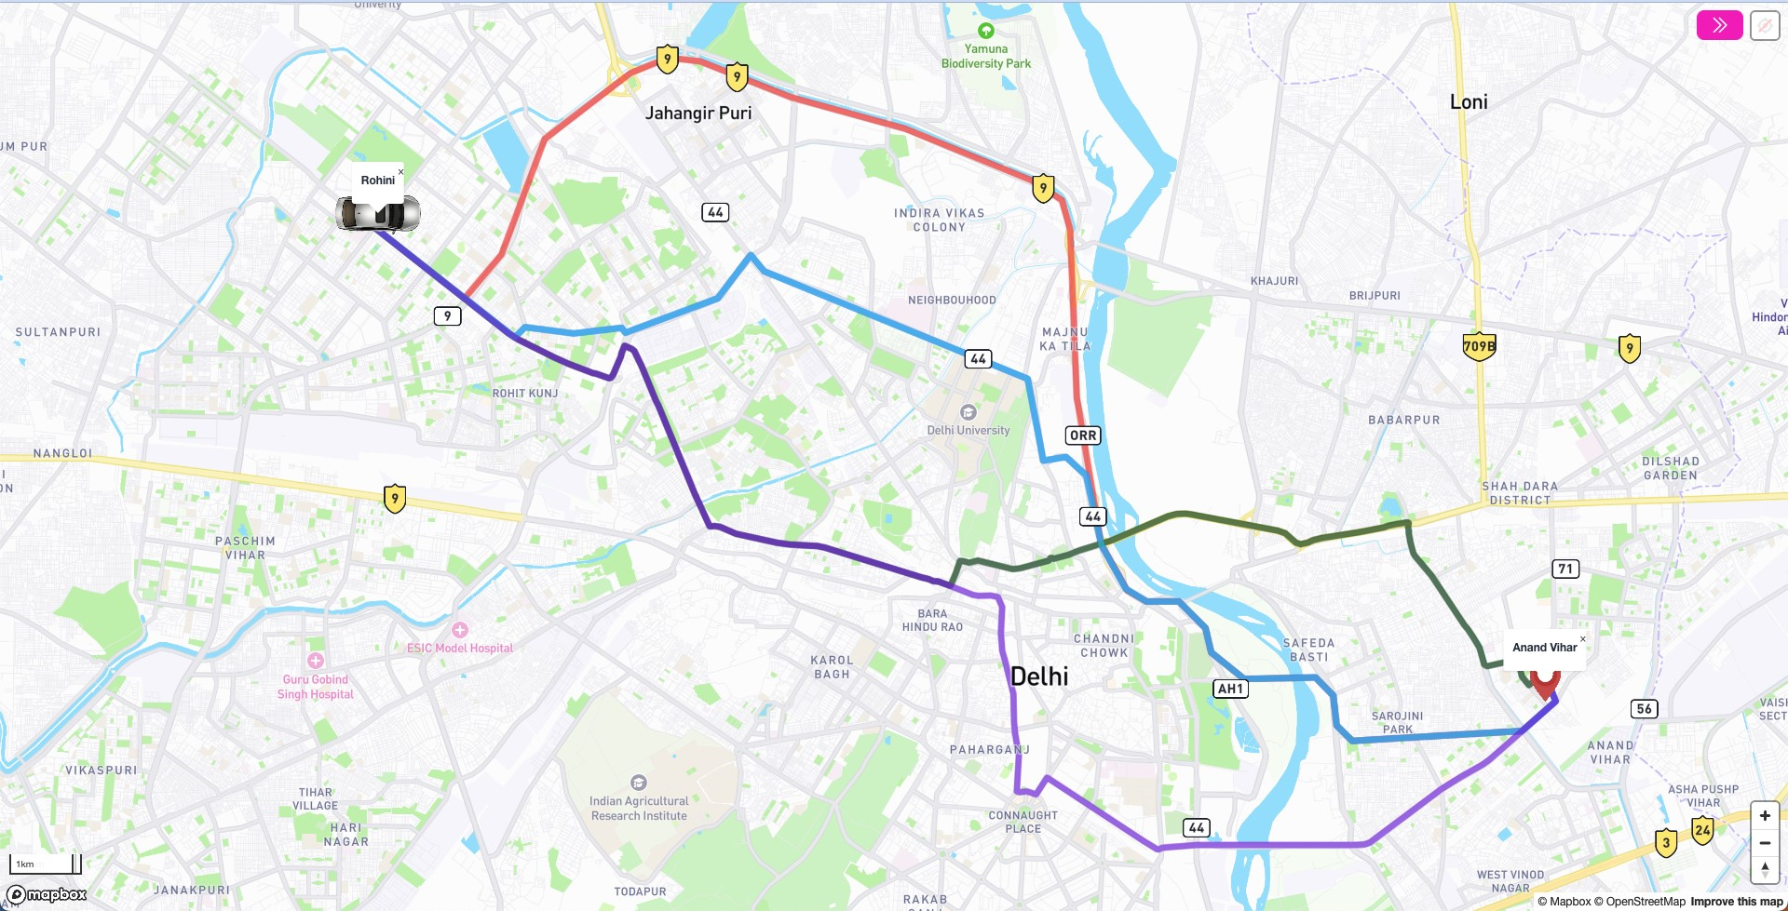

Objective of the Study
Google Map, that show
Shortest route,
Fastest route
DRUM (current application), that show:
Shortest route,
Fastest route,
Least air pollution route (LEAP),
Least energy consumption route (LECR),
Suggested route
Indian Institute of Technology Kharagpur, India

Slide 38
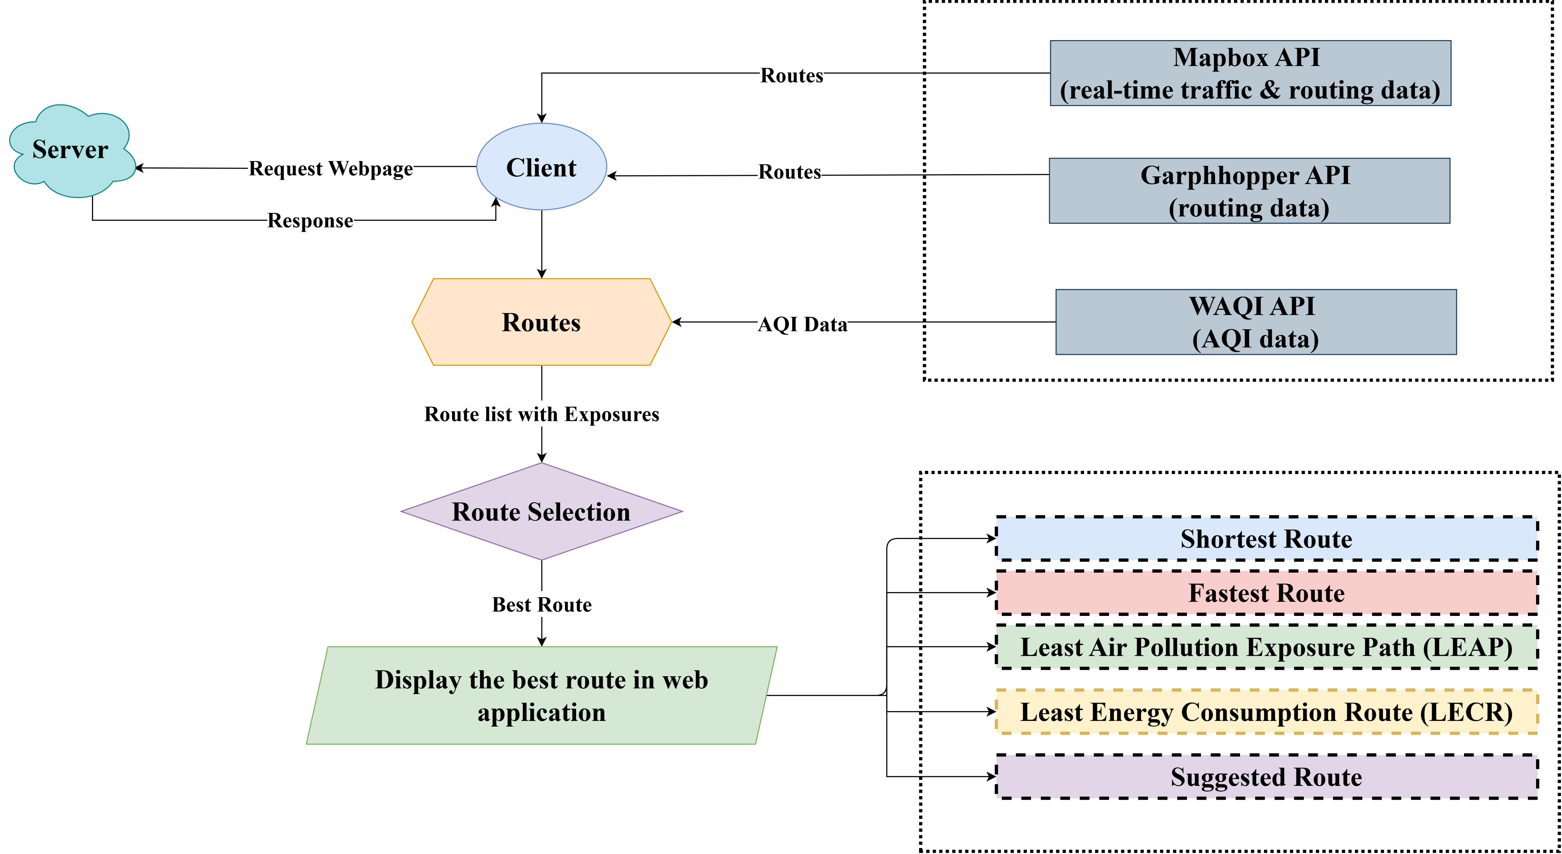
Methodology
Data
Routes
Indian Institute of Technology Kharagpur, India

Slide 39
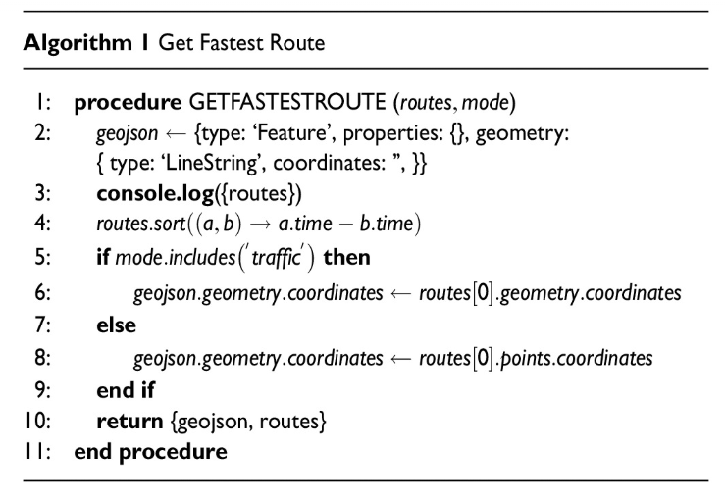
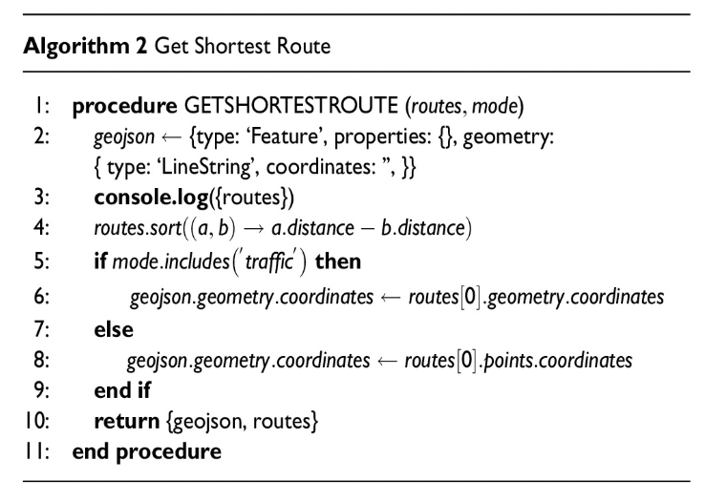
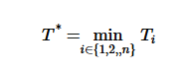
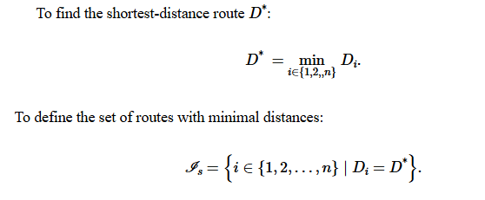
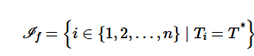
Algorithms
Indian Institute of Technology Kharagpur, India

Slide 40
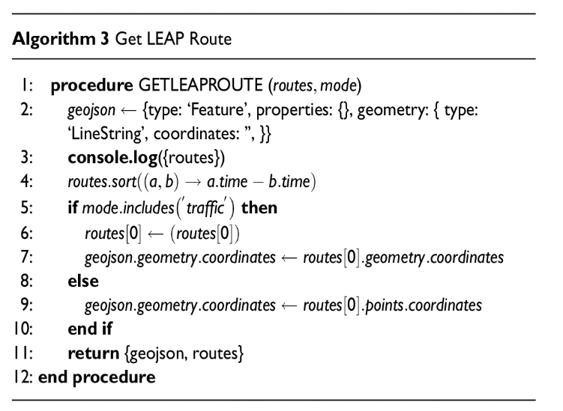
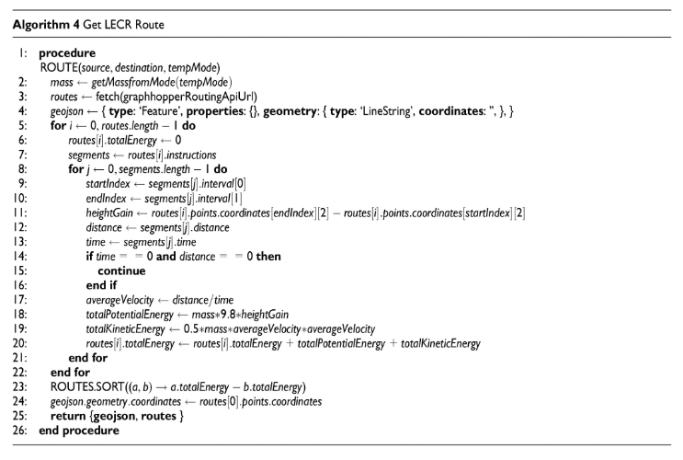


Algorithms
Indian Institute of Technology Kharagpur, India

Slide 41




Algorithms
Indian Institute of Technology Kharagpur, India

Slide 42

Framework of Application
Indian Institute of Technology Kharagpur, India

Slide 43


Demo of Application
Indian Institute of Technology Kharagpur, India

Slide 44


Results
Alternatives | East Delhi |  | South Delhi |  | North Delhi |  | Central Delhi
 | Car | 2W | Car | 2W | Car | 2W | Car | 2W
LEAP Vs. Fastest Route (Travel Time) | +24% | +36% | +54% | +7% | +35% | +8% | +42% | +16%
LEAP Vs. Fastest Route (Exposure) | -33% | -25% | -21% | -26% | -29% | -12% | -53% | -20%
LECR Vs. Fastest Route (Energy Saved) | 27% | 10% | 29% | 0% | 11% | 3% | 9% | 4%
Indian Institute of Technology Kharagpur, India

Slide 45





Sensitivity Analysis
A) Car
in Peak Hour
in Energy
Consumption
B) Two Wheeler
East Delhi
North Delhi
South Delhi
North Delhi
Indian Institute of Technology Kharagpur, India

Slide 46



Summary
Avoid Exposure by 53%
Increase in Travel Time by 42%
By using LEAP route in Central Delhi, user could,
By using LECR route user can save energy up to
in South Delhi
Indian Institute of Technology Kharagpur, India

Slide 47


A Multi-Modal Analytics System for Real-Time Air Quality Monitoring, Diagnostics, and Prediction

Slide 48
A Multi-Modal Analytics System for Real-Time Air Quality Monitoring, Diagnostics, and Prediction
Objectives:
1. To Design a Robust Data Pipeline:
To ingest, process, and unify heterogeneous data sources, including live feeds, historical archives, and geospatial data, into a single, analysis-ready dataset.
2. To Implement a Multi-Modal Analytics Engine:
To move beyond simple monitoring by developing an engine capable of performing:
Descriptive Analytics to understand current and historical trends.
Diagnostic Analytics to automatically identify anomalies and their potential causes.
Predictive Analytics to forecast future air quality conditions.
3. To Develop an Interactive and User-Centric Dashboard:
To present complex data and analytical insights through an intuitive visual interface, empowering researchers, policymakers, and analysts to make data-driven decisions.
Indian Institute of Technology Kharagpur, India

Slide 49


A Multi-Modal Analytics System for Real-Time Air Quality Monitoring, Diagnostics, and Prediction
Indian Institute of Technology Kharagpur, India

Slide 50


Findings
Phase 1: Data Ingestion and Curation
Phase 2: Multi-Modal Analytics
Engine
Phase 3: Interactive Dashboard

Slide 51




Publications
Journal Articles
J1. Meena, K. K., A. K. Singh, and A. K. Goswami (2025). “Dynamic route planning for urban green mobility: Development of a web application offering sustainable route options to commuters.” Transportation Research Record. doi:10.1177/0361198125133011.
J2. Manoj, B. S., K. K. Meena, and A. K. Goswami (2025). “A prioritization framework to identify key attributes of transit-oriented development (TOD) using a multi-criteria decision-making approach: An Indian context.” Sustainable Transport and Livability. doi:10.1080/29941849.2025.2516475.
J3. Manoj, B. S., K. K. Meena, H. Panchal, G. S. Sharma, and A. K. Goswami (2025). “An integrated choice latent variable (ICLV) model to assess the willingness to bicycle for the first mile: A case of Mumbai suburban rail.” International Journal of Sustainable Transportation (under second revision).
J4. Meena, K. K., and A. K. Goswami (2024). “A review of air pollution exposure impacts on travel behaviour and way forward.” Transport Policy. doi:10.1016/j.tranpol.2024.05.024.
Key Research Questions
Indian Institute of Technology Kharagpur, India

Slide 52






C1. Meena, K. K., and A. K. Goswami (2026). “Not all travellers think alike: Segmenting travel behaviour under air pollution exposure using a hybrid latent class and discrete choice approach.” Submitted to the Transportation Research Board (TRB) 2026 Annual Meeting, Washington, DC (Submitted).
C2. Singh, A., K. K. Meena, G. Sharma, A. K. Goswami, and S. Mishra (2026). “Developing an integrated walkability score using image-based feature extraction and user preferences.” Submitted to the Transportation Research Board (TRB) 2026 Annual Meeting, Washington, DC (Submitted).
C3. Manoj, B. S., K. K. Meena, and A. K. Goswami (2025). “A prioritization framework to identify key attributes of transit-oriented development (TOD) using a multi-criteria decision-making approach: An Indian context.” Presented at the 1st World Symposium on Sustainable Transport and Livability (WSSTL-2025), IISc Bengaluru, India.
C4. Sumbhate, A., K. K. Meena, and A. K. Goswami (2025). “Assessing the air pollution exposure to school children in different modes of transport while commuting to school: A case of Kharagpur, India.” In Proceedings of EASTS (Accepted).
C5. Kodukulla, R., K. K. Meena, G. Sharma, and A. K. Goswami (2025). “Accessibility assessment of urban public transit to key facilities through spatial analysis – A case study of Delhi.” In TIPCE, IIT Roorkee (Accepted).
C6. Dasgupta, S., K. Meena, D. Majumdar, and A. Goswami (2025). “Air pollution exposure among Kolkata’s auto-rickshaw drivers: PM variability, health risks, and predictive modeling.” In Energies, AEEE India (Accepted).
C7. Sumbhate, A., M. Kapil, and A. K. Goswami (2024). “Breathable modes to school: Assessing the air pollution exposure of travel choices for school children in urban environments.” Presented at the 52nd Urban Affairs Association (UAA) Annual Meeting, Nashville, Tennessee, USA.
C8. Mohanty, P., M. Kapil, and A. K. Goswami (2024). “Analysing user behaviour along dedicated bicycle facilities in an urban environment.” Presented at the 52nd Urban Affairs Association (UAA) Annual Meeting, Nashville, Tennessee, USA.
C9. Manoj, B. S., M. Kapil, Hiral, P., Gajanand, S., and A. Goswami (2024). “Assessing the willingness to bicycle for the first mile to the Mumbai suburban rail.” Presented at the 17th International Association for Travel Behaviour Research (IATBR), Vienna, Austria.
C10. Meena, K. K., and A. K. Goswami (2023). “A review of air pollution exposure impacts on travel behaviour and way forward.” Presented at the 16th World Conference on Transport Research (WCTR), Montréal, Canada.
C11. Meena, K., R. Kumar, and A. K. Goswami (2022). “On-road pollution exposure in multiple transport micro-environments: A case study of tier-2 and tier-3 cities in India.” Presented at the 14th International Conference on Transport Planning and Implementation Methodologies for Developing Countries (TPMDC), IIT Bombay, India.
Publications
Indian Institute of Technology Kharagpur, India

Slide 53

Extension Seminar Presentation

